Slide 1
Introduction to US Intellectual Property
Class 1
Henry Biggs
Washington University
Adjunct Professor of Law and Linguistics
hbiggs@wustl.edu
henrypbiggs@gmail.com
April 2, 2026

Slide 2
Introduction (your 3+ questions!)
1. Background: Henry Biggs
Former Associate Dean, Washington University
Adjunct Law Professor, Washington University
Adjunct Linguistics Professor, Washington University
2. Education:
BA Harvard, Classics (Latin)
PhD, UCLA 1995 (Computational and Romance Linguistics)
JD, LLM in Intellectual Property, Saint Louis Univ 2011, Wash Univ, 2013
M2, Paris-Dauphine, 2012
3. Languages:
French, German, Italian, English
4. Fun Facts:
Loooove cheese, like anchovies!
Ran 250 km Marathon des sables (2022), swam English Channel (12 hours 59 min, 34km)
5. Things you are afraid of:
Heights!

Slide 3

Your Background
1. Name
2. Education
3. Languages
4. One thing about you NOT found on your résumé

Slide 4
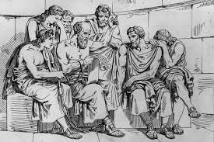
Class Structure
Discussion, Question-Answer
Gentler Socratic Method
Education as negative commodity
Once you buy it, you are happy to get less!
Revisions, focused repetition is key to retention
Occasional small group discussions
And we will also - mercifully - take a pause at the hour (:

Slide 5
Introduction to Fundamentals of U.S. Intellectual Property
Patents
Trademarks
Copyright
Trade Secrets (if time available)
Geographical Indications
Traditional Knowledge (TK), Traditional Cultural Expressions (TCE), & paying back an entire culture

Slide 6
First Foundations:
Understanding U.S.
Separation of Powers

Slide 7
The Powers
Legislative -
Senate - 100 members (elected every 6 years)
House - 435 members (elected every 2 years)
Judiciary -
9 Supreme Court Justices (life term)
Executive
President - maximum of 8 years, 2 terms
Elected every 4 years

Slide 8
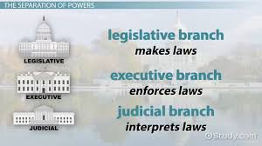
The Division of Responsibilities
Legislative - Write the laws
Judiciary - Judge the laws
Executive - Enforce the laws

Slide 9
What if the Executive Chooses
Not to Enforce the Laws
Because the Laws go against him/her?

Slide 10
Notable Differences from
British System
Prime Minister is elected by his party (not by the people); he is elected from among his peers in parliament - he is not elected separately by the people.
There is no constitution (!)
The judiciary cannot mark anything as unconstitutional (only inconsistent with prior laws) !

Slide 11
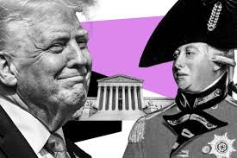
American/British
In short, ironically, in the American system the president has more potential to behave like a king than the prime minister does under the British system!

Slide 12
First Foundations, Part 2: Understanding US Common Law

Slide 13
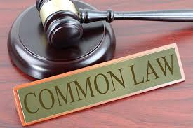
How would YOU say the Common Law system works?

Slide 14
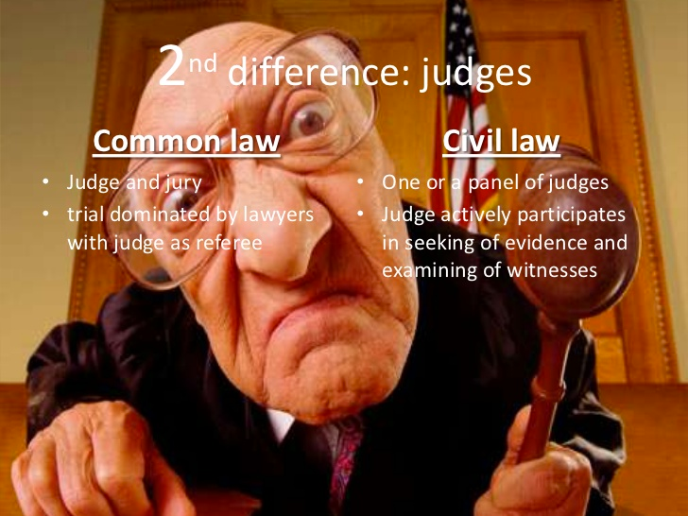

Slide 15
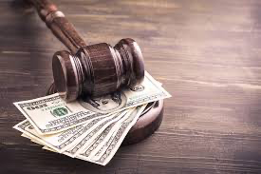
Who pays the legal fees?
U.K.?
U.S.?

Slide 16
Other forms of Settlement
Mediation
Arbitration
Negotiation

Slide 17
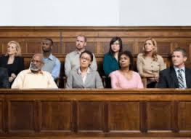
Juries and Big Business
Would you as an attorney for a big company
ask for a jury?

Slide 18
US Common Law Cycle
The path from going
from caselaw to a statute
Legislators write statutes
Judges apply and interpret those statutes, and in doing so, ultimately make new law and policy
RESTATEMENTS!
If legislators do not like the interpretation, they write new statutes

Slide 19

US Common Law Cycle
Over time, these are bound up in what are called Restatements
Restatements summarize the general trends of interpretations of judges on statutes all across the country
What are restatements?

Slide 20
Civil Law v. Common Law
Civil Law v. Criminal Law
The system of law predominant on the European continent, historically influenced by that of ancient Rome and Napoleon.
The system of law concerned with private relations between members of a community rather than criminal, military, or religious affairs.

Slide 21
Civil Law
A system of law whose most prevalent feature is that its core principles are codified into a referable system which serves as the primary source of law.

Slide 22
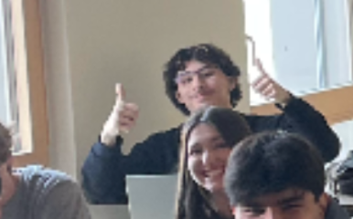
Best Photo - 10 bonus points
And the best macchiato ever

Slide 23


Slide 24


What is the difference between PROPERTY and INTELLECTUAL PROPERTY?
V
VS

Slide 25

Intellectual Property refers to creations of the mind -- intangible property that is NOT therefore exclusive or exhaustive.
For example:
(1) Inventions; literary and artistic works; and
(2) symbols, names and images used in commerce.
To motivate these creations we give the creators Limited/unlimited monopolies

Slide 26
Industrial Property
Intellectual property is divided into two categories:
1. Industrial Property which includes patents for inventions, trademarks, industrial designs and geographical indications (remember: trademarks on steroids!).

Slide 27
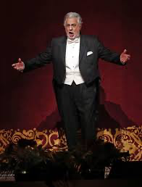
Performances
Copyright covers literary works (such as novels, poems and plays), films, music, artistic works (e.g., drawings, paintings, photographs and sculptures) and architectural design.
Titles to books? No copyright!
Computer code for your business software? Almost no copyright (:

Slide 28

Definitions
The Product
Intangible property that is the result of creativity, such as patents, copyrights…
Not exclusive – several may own at once
Do you think trademarks are creative?
The Protection:
Limited Monopoly - Monopoly!!
Write to exclude for any reason or no reason

Slide 29
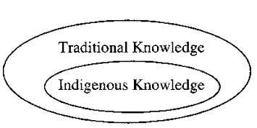
Exception?
Exception?
Exception?
Traditional Cultural Expressions
(TCE)

Slide 30
Contributory Sharing

Slide 31
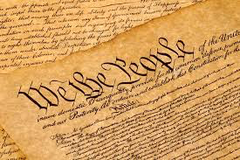
Where does UNITED STATES Intellectual Property Law Come From?
Focusing on U.S. Constitutional
Mandates

Slide 32
Article I, Clause 8, Section 8
Congress shall have the power :
To promote the Progress of Science (thought) and useful Arts (technology), by securing for limited Times to Authors and Inventors the exclusive Right to their respective Writings and Discoveries (monopoly)
MONOPOLY! Huge business advantage
Notes:
https://wipolex-res.wipo.int/edocs/lexdocs/laws/fr/fr/fr465fr.pdf
https://www.legifrance.gouv.fr/jorf/id/JORFTEXT000000357475/

Slide 33
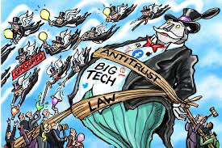
Limited Monopolies

Slide 34
For Writings (~copyright) and Discoveries (~patents)

Slide 35
Copyrights and Patents
The Constitutional mandate therefore must be that protections and laws will promote or further promote the sciences and the arts
If they are for justice, fairness or protection, or any other rationale, the constitutional mandate is compromised

Slide 36

Trademarks

Slide 37
U.S. Commerce Clause
Article I, Section 8, Clause 3:
Gives Congress the power…
“to regulate commerce with foreign nations, and among the several states, and with the Indian tribes.”
Are Indian (Native American) tribes distinct from U.S. law?
Casinos, Cigarette sales, etc on Native American lands
Notes:
Indian tribes termed Domestic Dependent Nations

Slide 38
The phenomenon of Trademark Genericide
Genericide: Overuse of a Trademark
Escalator
Elevator
Zipper
Close?
Google?
Xerox?
Velcro?
Video -

Slide 39
Trade Secrets

Slide 40
Commerce Law? “to regulate commerce with foreign nations, and among the several states, and with the Indian tribes.” Constitutional Mandate?

Slide 41

Made federal law, model act in 2016, Individual State laws, modeled after Uniform Trade Secrets Act (UTSA)
Notes:
http://www.uniformlaws.org/LegislativeFactSheet.aspx?title=Trade%20Secrets%20Act

Slide 42
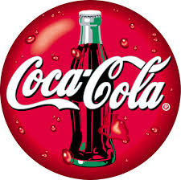
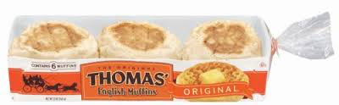
Famous Trade Secrets – a business decision/gamble
Coca Cola Recipe
Google’s algorithm
Thomas English Muffins
Why Trade Secrets and Not Patents?

Slide 43
FUNDAMENTAL RULES FOR IP

Slide 44
US Patent: Elements Importance for Business

Slide 45
First to File / First to Invent
If your invention happened in 2011 or after, you must be first to file rather than first to invent.
America Invents Act
What are the advantages of first to file? First to invent?

Slide 46
§ 101 Patentable Subject Matter
To be patent eligible subject matter, an invention must fall within one of the four statutory categories of acceptable subject matter:
(1) process, (2) machine, (3) manufacture, or (4) composition of matter.

Slide 47
Computers
What if you wrote a computer program that allowed the variables to be input and gave you the correct output? That’s a process no?
What if that computer program were part of another patent you were petitioning?
Could you make it a trade secret? How? Why?

Slide 48
§101 Patentable Subject Matter
Second, it must not be directed to subject matter encompassing a judicially recognized exception:
(1) laws of nature, (2) physical phenomena, and (3) abstract ideas.
Could they alternatively function in some way as trade secrets? How?

Slide 49
Physical Phenomena
Earthquakes
Plant Growth !
Hurricanes
Northern Lights - L’aurore boréale

Slide 50
Laws of Nature / Abstract Ideas
Force = Mass * Acceleration?
Pythagorean Theorem? A² + B² = C²?
E = MC²?
Justice? Peace?
But - as Trade Secrets?

Slide 51
Also USC 101 - Utility
The Office must examine each application to ensure compliance with the “useful invention” or utility requirement of 35 U.S.C. 101.

Slide 52
Utility USC 101
IV. UTILITY
A claimed invention must be useful or have a utility that is specific, substantial and credible.
A rejection on the ground of lack of utility is appropriate when
(1) it is not apparent why the invention is “useful” because applicant has failed to identify any specific and substantial utility and there is no well established utility, or
(2) an assertion of specific and substantial utility for the invention is not credible. Such a rejection can include the more specific grounds of inoperativeness, such as inventions involving perpetual motion.

Slide 53
“Morally Questionable”
Patents OK for Utility
A rejection under 35 U.S.C. 101 for lack of utility should NOT be based on grounds that the invention is frivolous, fraudulent or against public policy. See Juicy Whip →

Slide 54
Juicy Whip Inc. v. Orange Bang Inc.
“[Y]ears ago courts invalidated patents on gambling devices on the ground that they were immoral…, but that is no longer the law…Congress never intended that the patent laws should displace the police powers of the States, meaning by that term those powers by which the health, good order, peace and general welfare of the community are promoted…
…we find no basis in section 101 to hold that inventions can be ruled unpatentable for lack of utility simply because they have the capacity to fool some members of the public.”

Slide 55
Novelty §102
The claimed invention cannot have been:
Already patented
Described in a printed publication
In public use, on sale, or otherwise available to the public

Slide 56
Nonobviousness (§103)
(Intl: “Inventive step”)
An invention that would have been obvious to a person of ordinary skill at the time of the invention is not patentable (POSITA).
Is some part of your business process new but fairly obvious?
Notes:
35 U.S.C. 103 Conditions for patentability; non-obvious subject matter.
A patent for a claimed invention may not be obtained, notwithstanding that the claimed invention is not identically disclosed as set forth in section 102, if the differences between the claimed invention and the prior art are such that the claimed invention as a whole would have been obvious before the effective filing date of the claimed invention to a person having ordinary skill in the art to which the claimed invention pertains.

Slide 57
the POSITA/PHOSITA
Why is a POSITA the necessary standard
Person of Ordinary Skill In The Art
What does that mean?

Slide 58
Hindsight Bias
Let’s take a poll regarding the relationship between flattery and self-confidence
HANDOUT

Slide 59
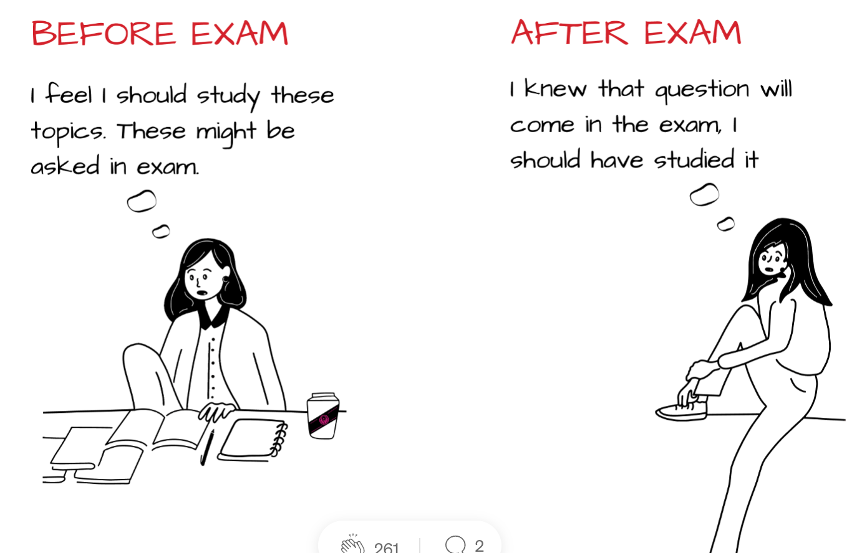
Hindsight Bias

Slide 60
How to Prevent Hindsight Bias for Judging Nonobviousness
Periodicals
Evidence that much effort has been made with no solution
Can you think of some things that we take for granted now, that were impossible to imagine 30 years ago? 50 years ago? 100 years ago?
Get it right so you do not waste your company’s time!

Slide 61
Duration of Protection: 20 years

Slide 62
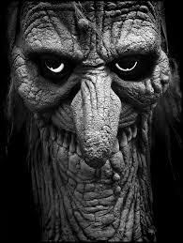
Challenges: Patent Trolls (Non practicing Entities) NPEs

Slide 63
What is a Patent Troll or NPE?

Slide 64
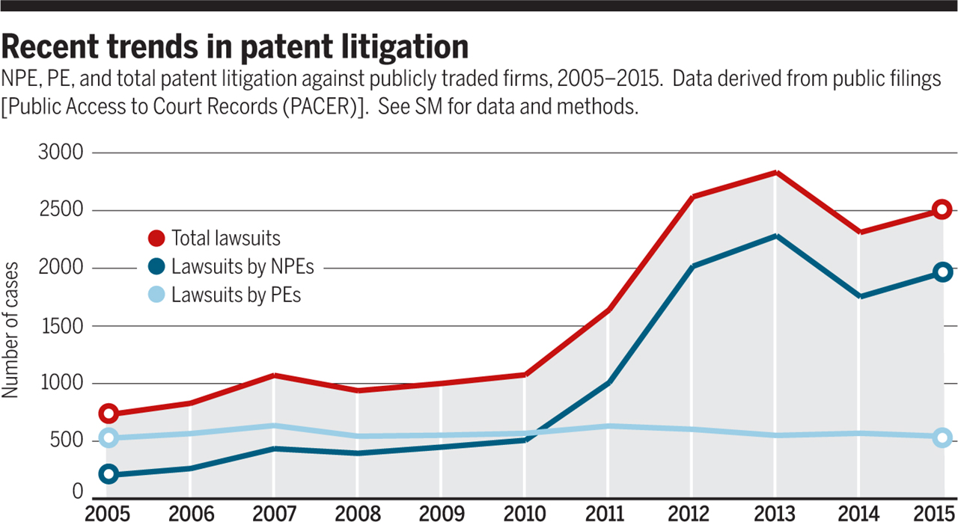
Patent Litigation 2015

Slide 65
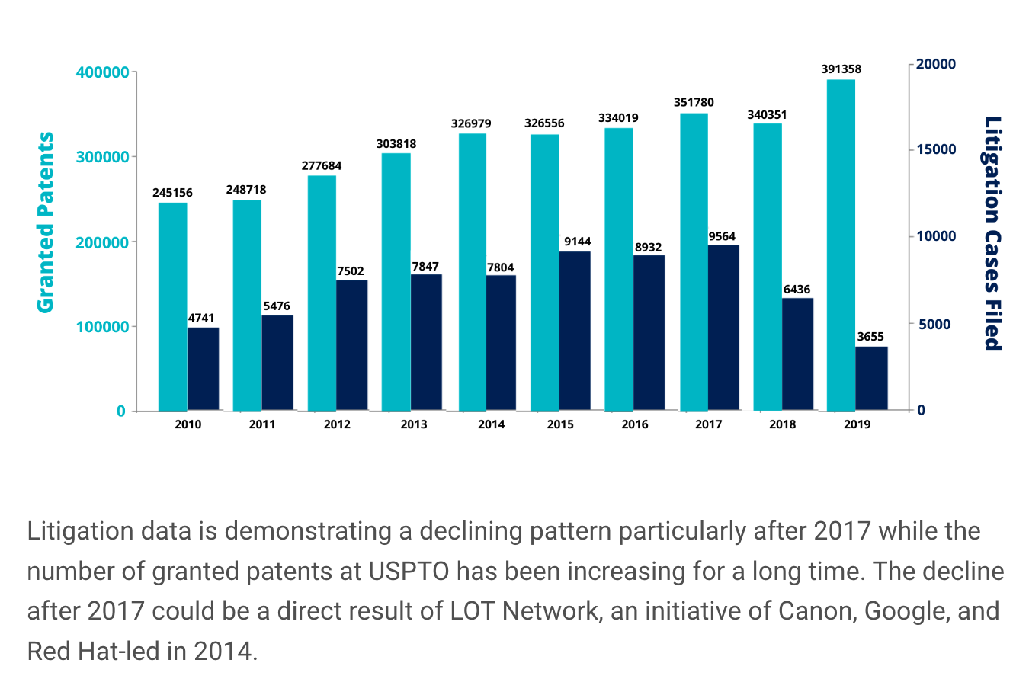
the LOT Network effect?
Notes:
Details here - https://lotnet.com/how-we-protect-members/
https://en.wikipedia.org/wiki/LOT_Network

Slide 66
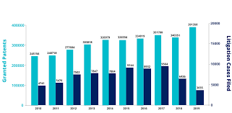
Litigation through 2019
Notes:
From https://insights.greyb.com/patent-litigation-trends-2019/

Slide 67
Do Patent Trolls Promote
the Progress of Science?
Article I, Clause 8, Section 8 -
Congress shall have the power :
To promote the Progress of Science (thought) and useful Arts (technology), …by securing for limited Times to Authors and Inventors the exclusive Right to their respective Writings and Discoveries (monopoly)
Does Patent Law Litigation “promote the progress of the Arts and Sciences”?

Slide 68
Ebay v. MercExchange (2006)

Slide 69
What is Ebay? Have you ever used it?

Slide 70
Ebay v. MercExchange
Online auction site eBay uses practices in its online auction technology for which MercExchange owns patents for over 30 percent of the company's business.
In 2000, eBay initiated negotiations to outright purchase MercExchange's online auction patent portfolio.

Slide 71
Ebay v. Merc Exchange (cont)
When eBay abandoned its effort, MercExchange sued eBay for patent infringement and prevailed in a 2003 Virginia jury trial, which found eBay had willfully infringed the MercExchange's patents and ordered a payment of nearly $30 million in damages.

Slide 72
Ebay v. MercExchange (cont)
Following the verdict, MercExchange sought an injunction to prevent eBay's continued use of its intellectual property, but the District Court denied the request.

Slide 73
Ebay v. MercExchange (4 factor Injunction Test)
(1) that it has suffered an irreparable injury; (2) that remedies available at law are inadequate to compensate for that injury;
(3) that considering the balance of hardships between the plaintiff and defendant, a remedy in equity is warranted; and
(4) that the public interest would not be disserved by a permanent injunction.

Slide 74
Who sues the most?

Slide 75
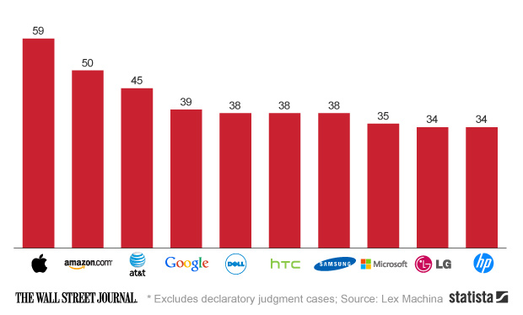
Who Sues? (2013)

Slide 76
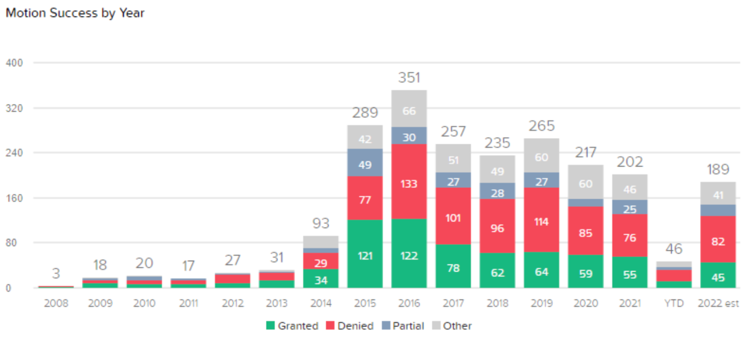
Total Patent Motions (2022)

Slide 77
Patent Case Law

Slide 78
Patent Case law
Patentable Subject Matter
Diamond v. Chakrabarty
Utility or Industrial Application
Diamond v. Diehr
Novelty
Rosaire v. National Lead Co
Nonobviousness or Inventive Step
Graham v. Deere

Slide 79
Patentable Subject Matter Diamond v. Chakrabarty
Any of you interested in pursuing business in the area of science?
Title 35 U.S.C. 101 provides for the issuance of a patent to a person who invents or discovers "any" new and useful "manufacture" or "composition of matter."
Chakrabarty filed a patent application relating to his invention of a human-made, genetically engineered bacterium capable of breaking down crude oil, a property which is possessed by no naturally occurring bacteria.
Useful? Nonobvious? Novel?

Slide 80
Diamond v. Chakrabarty
Patent office rejected – why?
Patent Office Board of Appeals Affirmed
Court of Customs and Patent Appeals Reversed– Why?
Supreme Court Affirmed

Slide 81
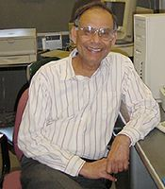
Diamond v. Chakrabarty
Court of Customs and Patent Appeals:
The Court of Customs and Patent Appeals reversed, concluding that the fact that micro-organisms are alive is without legal significance for purposes of the patent law.
Supreme Court
A live, human-made micro-organism is patentable subject matter under 101.
Respondent's micro-organism constitutes a "manufacture" or "composition of matter" within that statute.

Slide 82
Utility or Industrial Application Diamond v. Diehr
Addressed the issue of converting rubber into cured precision products (mainly tires).
While it was possible, by using well-known time, temperature, and cure relationships, to calculate by means of an established mathematical equation when to open the molding press and remove the cured product,
according to respondents the industry had not been able to measure precisely the temperature inside the press, thus making it difficult to make the necessary computations to determine the proper cure time.

Slide 83
Diamond v. Diehr
The rare algorithm
that becomes part of a patent!
Respondents characterized their contribution to the art to reside in the process of constantly measuring the temperature inside the mold and feeding the temperature measurements into a computer that repeatedly recalculates the cure time by use of the mathematical equation and then signals a device to open the press at the proper time.

Slide 84
Diamond v. Diehr
The patent examiner rejected respondents' claims on the ground that they were drawn to nonstatutory subject matter under 35 U.S.C. 101, which provides for the issuance of patents to:
"[w]hoever invents or discovers any new and useful process, machine, manufacture, or composition of matter, or any new and useful improvement thereof . . . ." The Patent and Trademark Office Board of Appeals agreed, but the Court of Customs and Patent Appeals reversed.

Slide 85
Nonobviousness Graham v. Deere

Slide 86
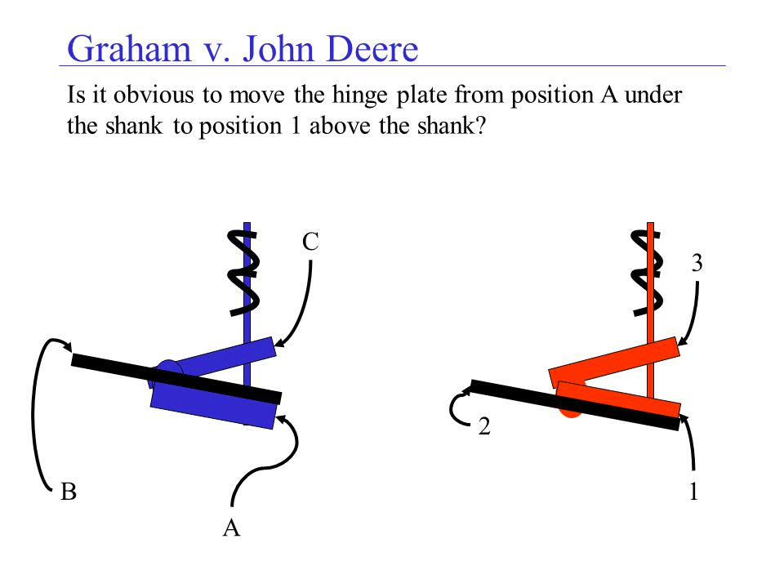
Graham v. Deere

Slide 87
Nonobviousness or Inventive Step Graham v. Deere
Petitioners sued for infringement of a patent, consisting of a combination of old mechanical elements, for a device designed to absorb shock from plow shanks in rocky soil to prevent damage to the plow.
the Fifth Circuit held the patent valid, ruling that a combination is patentable when it produces an "old result in a cheaper and otherwise more advantageous way."

Slide 88
Graham v. Deere
the Eighth Circuit, however, held that since there was no new result in the combination the patent was invalid.
Petitioners filed actions declaring invalid respondent's patent relating to a plastic finger sprayer with a "hold-down" cap used as a built-in dispenser for containers with liquids, principally insecticides. By cross-action respondent claimed infringement.

Slide 89
Graham v. Deere
The District Court and the Court of Appeals sustained the patent.
Held:
The patents do not meet the test of the "nonobvious" nature of the "subject matter sought to be patented" to a person having ordinary skill in the pertinent art.

Slide 90
Graham v. Deere
"[U]nless more ingenuity and skill . . . were required . . . than were possessed by an ordinary mechanic acquainted with the business, there was an absence of that degree of skill and ingenuity which constitute essential elements of every invention. In other words, the improvement is the work of the skillful mechanic, not that of the inventor." At p. 267.

Slide 91
Graham v. Deere
Certainly a person having ordinary skill in the prior art, given the fact that the flex in the shank could be utilized more effectively if allowed to run the entire length of the shank, would immediately see that this was the thing to do.

Slide 92
Graham v. Deere
In other words, the stirrup in Glencoe serves exactly the same function as the heel of the hinge plate in '798.
The mere shifting of the wear point to the heel of the '798 hinge plate from the stirrup of Glencoe - itself a part of the hinge plate - presents no operative mechanical distinctions, much less nonobvious differences.

Slide 93
Nonobvious? Arkie Lures

Slide 94
Arkie Lures
Gene Larew, a retired engineer, set out to make a plastisol fishing lure that would have a salty taste for a prolonged period in water, as compared with the salty baits then known.
In his patent, Larew noted that a striking fish will retain a salty-tasting lure for a longer time, thereby improving the fisherman's chance to set the hook.

Slide 95
Arkie Lure v. Larew
Upon extreme persistence by Mr. Larew the product was eventually produced.
The first commercial salt-impregnated plastic lure was called the “Gene Larew Salty Frog.”
It was an immediate commercial success. Arkie Lures copied the Larew lure and, declined Mr. Larew's offer of a license, stating that the addition of salt to a lure was “obvious”.
Is it?

Slide 96
Larger Question:
Being a Lawyer
STRICTLY Applying the Éléments

Slide 97
Assault - the Elements
(1) The act was intended to cause apprehension of harmful or offensive contact; and
(2) The act indeed caused reasonable apprehension in the victim that harmful or offensive contact would occur.
(3) An imminent physical gesture signifying a threat

Slide 98
BATTERY
(Elements)
The prima facie case for battery contains 4 components:
(1) The defendant acts.
(2) The defendant intends to cause contact with the victim.
(3) The defendant's contact with the victim is harmful or offensive.
(4) The defendant's contact causes the victim to suffer a contact that is harmful or offensive.

Slide 99
Scenario - Assault or Battery
George is looking for Joe who he is sure wants to hurt him. He is walking down the highway.
Joe is driving his car and sees that George is on the other side. George does not see Joe. Joe turns his car around to park and confront Joe and loses control of his vehicle, running into and hurting George. Was their assault? Battery?

Slide 100
Assault - The Elements
(1) The act was intended to cause apprehension of harmful or offensive contact; and
(2) The act indeed caused reasonable apprehension in the victim that harmful or offensive contact would occur.
(3) An imminent physical gesture signifying a threat

Slide 101
Battery - the elements
BATTERY
The prima facie case for battery contains 4 components:
(1) The defendant acts.
(2) The defendant intends to cause contact with the victim.
(3) The defendant's contact with the victim is harmful or offensive.
(4) The defendant's contact causes the victim to suffer a contact that is harmful or offensive.

Slide 102
Trends and Themes in
International Patent Law
Working with the inventive step
Defining Scope of those eligible for inventive step: (1) Agriculture
(2) Pharmaceuticals

Slide 103
END PATENT LAW

