Slide 1
Class 02 - Trademarks
Slovenia/Erasmus
April 3, 2026

Slide 2
Follow up Qs
For You

Slide 3
What did we learn
about Patents on March 9?
-> 4 Requirements
-> Duration of Protection

Slide 4
Patentable Subject Matter

Slide 5
Novelty

Slide 6
Utility

Slide 7
Nonobviousness

Slide 8
POSITA/PHOSITA

Slide 9
Hindsight Bias

Slide 10
Patent Trolls

Slide 11
Do Patent Trolls Promote
the Progress of Science?
Article I, Clause 8, Section 8 -
Congress shall have the power :
To promote the Progress of Science (thought) and useful Arts (technology), …by securing for limited Times to Authors and Inventors the exclusive Right to their respective Writings and Discoveries (monopoly)
Does Patent Troll Litigation “promote the progress of the Arts and Sciences”?

Slide 12
TRADEMARKS!™

Slide 13
Understanding
U.S. Trademark Law (The Lanham Act)

Slide 14
How is Trademark law similar to Tort law?

Slide 15
Damages to Person ( e.g., Assault, Battery, Infliction of Emotional Distress)
v.
Damages to Business
(e.g, Dilution, Likelihood of Confusion)

Slide 16
The Lanham Act
US Trademark Statute

Slide 17
§1125 FALSE DESIGNATIONS
OF ORIGIN, FALSE DESCRIPTIONS…
(1) Any person who, on or in connection with any goods or services, or any container for goods, uses in commerce any word, term, name, symbol, or device, or any combination thereof, or any false designation of origin, false or misleading description of fact, or false or misleading representation of fact, which—

Slide 18
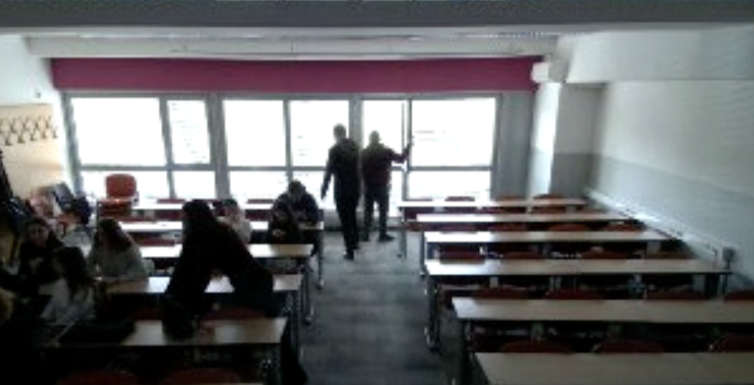

Slide 19
Trademark Law (Lanham Act)
(A) is likely to cause confusion, or to cause mistake, or to deceive as to the affiliation, connection, or association of such person with another person, or as to the origin, sponsorship, or approval of his or her goods, services, or commercial activities by another person, or

Slide 20
US Trademark Law (Geographic Indications Ramifications)
(B) in commercial advertising or promotion, misrepresents the nature, characteristics, qualities, or geographic origin of his or her or another person's goods, services, or commercial activities, shall be liable in a civil action.

Slide 21
How to DETERMINE Likelihood of Confusion:
The Polaroid Factors

Slide 22
Polaroid Factors (from case law v. Polaroid)
Strength of the plaintiff's trademark
Degree of similarity between the two marks at issue
Similarity of the goods and services at issue
…
Notes:
Polaroid v. Polaroid

Slide 23
Polaroid Factors (cont.)
Evidence of actual confusion
Purchaser sophistication
Quality of the defendant's goods or services
Whether the defendant's attempt to register the trademark was bona fide (in good faith).

Slide 24


Group Activity:
Dropbox v. Box -
Likelihood of Confusion?
V.

Slide 25
Polaroid Factors
Applied to Dropbox/Box)
Strength of the plaintiff's trademark
Do you know Dropbox? Box?
Degree of similarity between the two marks at issue
Name? Image? Colors?
Similarity of the goods and services at issue
Both products are file storage systems, offering virtually identical services
Notes:
Polaroid v. Polaroid

Slide 26
Polaroid Factors for Dropbox/Box
Evidence of actual confusion
Have YOU ever confused these two?
Purchaser sophistication
Who buys Dropbox? Who buys Box?
Quality of the defendant's goods or services
The quality of both goods is equal
Whether the defendant's attempt to register the trademark was bona fide (in good faith).
Both have registered their marks in good faith

Slide 27
Sooo, whaddaya think?

Slide 28
Trademarks and the Internet:
URL Ownership
&
Freedom of Expression

Slide 29
URL Rights for Business
Rights to McDonalds.com?
Rights to McDonaldsIsTerrible.com?
PETA.org
People for the Ethical Treatment of Animals
People Eating Tasty Animals (newly formed non-profit)

Slide 30
Trademark Dilution -
Two Types

Slide 31
Dilution by blurring
Dilution by blurring is association arising from the similarity between a mark or trade name and a famous mark that impairs the distinctiveness of the famous mark.
Rolls Royce Chewing Gum?
Louis Vuytton Notebooks?

Slide 32
Dilution by Tarnishment
When the reputation of a famous mark is harmed through association with another similar mark or trade name.

Slide 33
Dilution Factors
The degree of similarity between the mark or trade name.
The degree of inherent or acquired distinctiveness of the famous mark.
The extent to which the owner of the famous mark is engaging in substantially exclusive use of the mark.

Slide 34
Dilution Factors
4. The degree of recognition of the famous mark.
5. Whether the user of the mark intended to create an association with the famous mark.
6. Any actual association between the mark or trade name and the famous mark.

