Slide 1
Slovenia/Erasmus Trademark/Copyright
Friday, April 3, 2026

Slide 2
TRADEMARK:
The Spectrum of Distinctiveness

Slide 3
Trademark Distinctiveness
Greatest
Protection
Least Protection
Distinctive Spectrum
Fanciful
Kodak
Arbitrary
- Apple
Descriptive
American Airlines
Generic/Genericide
Band-aids, elevator, escalator

Slide 4
Which type of mark on the spectrum would you go for?

Slide 5
Trademark Duration of Protection: Unlimited

Slide 6
Trademark Case Law
Likelihood of Confusion
AMF v. Sleekcraft Boats
Spectrum of Distinctiveness
Abercrombie and Fitch
Dilution
Louis Vuitton v. Haute Diggity Dog, LLC

Slide 7
Louis Vuitton v. Haute Diggity Dog
Case Facts:
Haute Diggity Dog produces dog apparel. These are mock versions of high end products.
For example:
Chewy Vuiton
Chewnel no. 5
Furcedes
Dog Perignon

Slide 8
Louis Vuitton sues for Dilution—outcome?

Slide 9
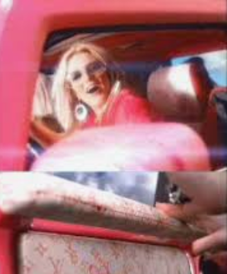
Louis Vuitton v. Brittney Spears
Outcome?

Slide 10
Trademarks
Likelihood of confusion
Dilution – by blurring and tarnishment
Duration
Unlimited

Slide 11
Trade Secrets
(very simple!)
Something of economic value
Reasonable efforts to conceal the item
Uniform Trade Secrets Act (UTSA)
Duration of Protection:
Unlimited

Slide 12
Copyright
Fixed Medium
Right to sell, make derivative works, distribute, perform
Duration:
Life of the author plus 70 years

Slide 13
Copyright -
Continued

Slide 14
17 US §102
(a) Copyright protection subsists, in accordance with this title, in original works of authorship fixed in any tangible medium of expression,

Slide 15
17 US §102
…now known or later developed, from which they can be perceived, reproduced, or otherwise communicated, either directly or with the aid of a machine or device.

Slide 16
§ 106: Rights bestowed
(1) to reproduce the copyrighted work in copies
(2) to prepare derivative works based upon the copyrighted work;
(3) to distribute copies of the copyrighted work to the public by sale rental, lease, or lending;

Slide 17
§106: Rights Bestowed
(4) in the case of literary, musical, dramatic, and choreographic works, pantomimes, and motion pictures and other audiovisual works, to perform the copyrighted work publicly;

Slide 18
§106: Rights Bestowed
(5) in the case of literary, musical, dramatic, and choreographic works, pantomimes, and pictorial, graphic, or sculptural works, including the individual images of a motion picture or other audiovisual work, to display the copyrighted work publicly; AND

Slide 19
§106
(6) in the case of sound recordings, to perform the copyrighted work publicly by means of a digital audio transmission.

Slide 20
Copyright U.S. Term Limit: The Life of the Author + 70 years

Slide 21
Has U.S/World Copyright Protection Been Overextended?

Slide 22
Protection of Copyright History
Act of 1790: 14 years; 14 year renewal
Act of 1831: 28 years; 14 year renewal
Notes:
https://www.wto.org/french/tratop_f/trips_f/intel2_f.htm#copyright
ADPIC:

Slide 23
Extensions of Copyright
Act of 1909: 28 years; 28 year renewal
Act of 1976: 75 years or the life of the author plus 50 years
CTEA of 1998: The life of the author plus 70 years (the Mickey Mouse Act)

Slide 24
International Copyright Agreements
Berne Convention Life of the author plus 50 years (Article 7.1) (1886)
ADPIC (TRIPS): Life of the author plus 50 years (1995)
Intellectual Property Agreement leveraged through Trade agreements

Slide 25
Does US Copyright Law make sense? Predicated on the mandate to help promote creativity

Slide 26
Does this promote creativity?

Slide 27
Creating for no money
YouTube
Fan Fiction
Slash Fiction

Slide 28
Other powerful psychological factors
Mastery
Autonomy
Attribution
Social Pressures

Slide 29
Money is not always the answer
If a person were to give you $50 because you invited them over to a fantastic dinner, would you be more or less motivated to invited them over again?

Slide 30
Money not always the answer
If you were to make a bargain between two players: first player gets to choose the split of $100 dollars, second player gets to accept or not. Would you always take the bargain as second player?

Slide 31
Money not always the Answer
An Israeli day care was frustrated that parents were not picking their children up on time
So they charged a fine
The rate of non-compliance actually grew!
Again, money is not always the answer…

Slide 32
Are current copyright
laws actually diminishing creativity?

Slide 33
In some ways…
Orphan works
Extensive protection that does not allow derivative works to bloom
The Wide Sargasso Sea // Jane Eyre
Rosencrantz and Guildenstern are Dead // Hamlet
The Wind done gone // Gone with the Wind (Fair Use)

Slide 34
Examples of
Copyright Infringement
in Music?
https://drive.google.com/file/d/1VN0BWJ8i54KkUZJ-jubUh0LcIebCwPNN/view?usp=share_link

Slide 35
Copyright Infringement in Art?
Isgrò v. Waters

Slide 36
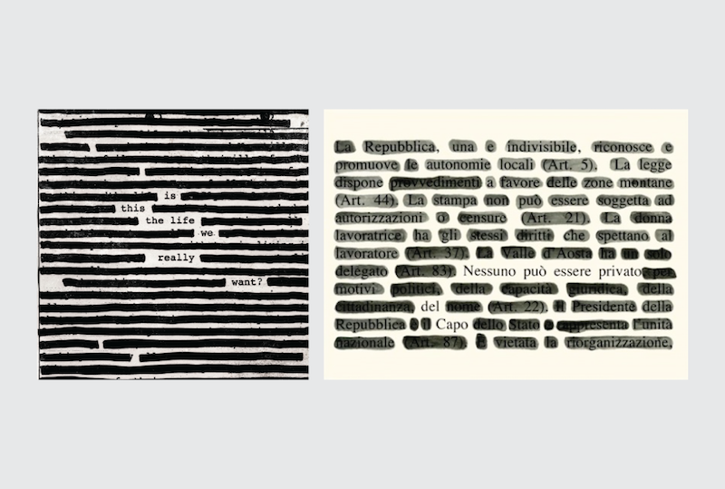

Slide 37
Copyright Protection
Extensions Meet Google and Wikipedia
and Hit a Wall!

Slide 38
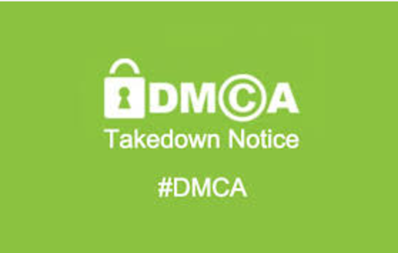
DMCA
The Digital Millennium Copyright Act (DMCA) was adopted in 1998.
An implementation of WIPO Treaty (World Intellectual Property Organization).

Slide 39
Safe Harbor Provision (Section 512)
Provides protection for Internet Service Providers – they are not responsible for the content on their site if they take reasonable measures.
Why is this disappointing for suing litigants?
TRUMP did not like this provision!

Slide 40
Internet Being Born
Google (1998)
Wikipedia (2001)

Slide 41
DMCA
The goal was to create a law that might address the specific issues of the digital age

Slide 42
DMCA
Among the requirements, the DMCA provided protection against people who tried to get around copyright protections on the internet

Slide 43
DMCA
Not done there, they also provided against the very making of anything that might allow a person to get around a copyright protection
The potential death of Fair Use?

Slide 44
SOPA (2011) Stop Online Piracy Act
Google and Wikipedia with leverage and power unrecognizable 10 years prior
Shut down operations, protesting SOPA, citizens revolt against legislators
Bill tabled

Slide 45
Why?

Slide 46
Fair Use!

Slide 47
Fair Use
Google realized that it could not photocopy the billions of pages it needed to for many of its Google search functions to work well.
Wikipedia realized it could never police all of its pages appropriately for copyright infringement.

Slide 48
QUICK REVIEW
BEFORE GROUP ACTIVITY

Slide 49
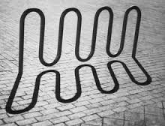
Your turn
Your client has created a bike rack and wants to apply for a patent. You find that it is rather a piece of art and so perhaps more a creature of copyright ... Defend first the rationale for these two approaches and then decide which rationale you find more reasonable ...
Notes:
Brandir International, Inc., Plaintiff-appellant, v. Cascade Pacific Lumber Co., D/b/a Columbia Cascade Co 1987

Slide 50
PETA - Bad Faith
The Rights to PETA.com or PETA.org?
PETA.org
People for the Ethical Treatment of Animals
People Eating Tasty Animals (newly formed non-profit)
Notes:
https://en.wikipedia.org/wiki/People_for_the_Ethical_Treatment_of_Animals_v._Doughney

Slide 51

Tasty Animals
At the bottom of the page, the website inquired "Feeling lost? Offended? Perhaps you should, like, exit immediately" and provided a link to the official People for the Ethical Treatment of Animals (PETA) website,^{[2]} which due to Doughney's action had to use a less intuitive domain name.

Slide 52
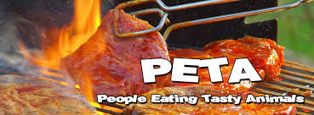
Tasty Animals
In 1995, Michael Doughney registered the domain name peta.org for his website titled "People Eating Tasty Animals".^{[1]}
The website contained links to over 30 sites including some that promoted the sale of leather goods and meats.

Slide 53
Copyright & Music
Listen to the following songs - copyright infringement or not?
Infringement or not?

Slide 54
Difficult Model for Businesses to Combat
Microsoft v. Open Source
How can businesses compete with free?

Slide 55
Is Intellectual Property DISCOURAGING Creativity?

Slide 56
Patent Impingements: Patent Trolls

Slide 57
In some ways…
Orphan works
Extensive protection that does not allow derivative works to bloom
The Wide Sargasso Sea // Jane Eyre
Rosencrantz and Guildenstern are Dead // Hamlet
The Wind done gone // Gone with the Wind (Fair Use)

Slide 58
In the news

Slide 59
FAIR USE

Slide 60
Fair Use
Google realized that it could not photocopy the billions of pages it needed to for many of its Google search functions to work well.
Wikipedia realized it could never police all of its pages appropriately for copyright infringement.

Slide 61
REVIEW

Slide 62
Patents
Patentable Subject Matter
Inventive Step, Novelty
Nonobviousness (Hindsight Bias)
Utility, Industrial Application
Duration:
20 years

Slide 63
Trademarks
Likelihood of confusion
Dilution – by blurring and tarnishment
Unfair Competition
Duration
Unlimited

Slide 64
Trade Secrets
Something of economic value
Reasonable efforts to conceal the item
Uniform Trade Secrets Act (UTSA) so individual State law
Duration
Unlimited

Slide 65
Copyright
Fixed Medium
Right to sell, make derivative works, distribute, perform
Duration:
Life of the author plus 70 years

Slide 66
FAIR USE / FAIR DEALING (l’utilisation equitable)

Slide 67
FAIR USE

Slide 68
Public Interest?
[Copyright] is intended to motivate the creative activity of authors and inventors by the provision of a special reward, and to allow the public access to the products of their genius after the limited period of exclusive control has expired.
Sony Corporation of America v. Universal City
Notes:
p. 584 Sony Corporation of America v. Universal City
[Copyright] is intended to motivate the creative activity of authors and inventors by the provision of a special reward, and to allow the public access to the products of their genius after the limited period of exclusive control has expired.
Sony Corporation of America v. Universal City
“The sole interest of the United States and the primary object in conferring the monopoly lie in the general benefits derived by the public from the labors of authors.” Chief Justice Hughes, United States v. Paramount Pictures 334 US 131, 158
[Copyright] vise à motiver l'activité créatrice des auteurs et des inventeurs en leur accordant une récompense spéciale et à permettre au public d'accéder aux produits de leur génie après l'expiration de la période limitée de contrôle exclusif.
Sony Corporation of America c. Universal City, 464 US 417 (1984).
«Le seul intérêt des États-Unis et le principal objet de l'octroi d’un monopole résident dans les avantages généraux que le public tire de des oeuvres des auteurs».
États-Unis c. Paramount Pictures 334 US 131, 158

Slide 69
Copyright
“The sole interest of the United States and the primary object in conferring the monopoly lie in the general benefits derived by the public from the labors of authors.” Chief Justice
Hughes, United States v. Paramount Pictures 334 US 131, 158

Slide 70
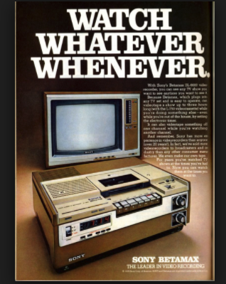
Sony v. Universal Studios
Betamax
Notes:
In the 1970s, Sony developed the Betamax video tape recording format. Universal Studios and the Walt Disney Company were among the film industry members who were wary of this development, but were also aware the U.S. Congress was in the final stages of a major revision of copyright law and would likely be hesitant to undertake any new protections for the film industry. The companies therefore opted to sue Sony and its distributors in California District Court in 1976, alleging that because Sony was manufacturing a device that could be used for copyright infringement, they were thus liable for any infringement committed by its purchasers.

Slide 71
Sony v. Universal Studios
In the 1970s, Sony developed the Betamax video tape recording format. Universal Studios and the Walt Disney Company were among the film industry members who were wary of this development, but were also aware the U.S. Congress was in the final stages of a major revision of copyright law and would likely be hesitant to undertake any new protections for the film industry.
Notes:
Porter des accusations -- file charges
Poursuivre en justice – sue
Intenter un procès – sue
Dans les années soixante-dix, Sony avait développé un format d'enregistrement -- Betamax -- qui permettait d'enregistrer des émissions et de les regarder plus tard. Il permettait également des enregistrements illicites. Universal Studios et Disney se mefiaient donc de son développement.
Universal Studios a decidé d’intenter un procès contre Sony en 1977, soutenant que Sony était responsable pour les infractions commises par sa technologie (responsabilité indirecte)

Slide 72
Sony v Universal Studios
The companies therefore opted to sue Sony and its distributors in California District Court in 1976, alleging that because Sony was manufacturing a device that could be used for copyright infringement, they were thus liable for any infringement committed by its purchasers.

Slide 73
Sony v. Universal Studios
The companies therefore opted to sue Sony and its distributors in California District Court in 1976, alleging that because Sony was manufacturing a device that could be used for copyright infringement, they were thus liable for any infringement committed by its purchasers.
Notes:
Les sociétés ont donc décidé de poursuivre Sony et ses distributeurs devant le tribunal de grande instance de Californie en 1976, alléguant que, du fait qu'elles pouvaient être utilisées pour une violation du droit d'auteur, elles étaient également responsables de toute infraction commise par ses acquéreurs.

Slide 74
Sony v. Universal Studios
The Court held (5-4)
[There must be] a balance between a copyright holder's legitimate demand for effective - not merely symbolic - protection of the statutory monopoly, and the rights of others freely to engage in substantially unrelated areas of commerce.
Notes:
[There must be] a balance between a copyright holder's legitimate demand for effective - not merely symbolic - protection of the statutory monopoly, and the rights of others freely to engage in substantially unrelated areas of commerce.
La Cour a statué (5-4):
[Il doit y avoir] un équilibre entre la demande légitime d'un détenteur de droit d'auteur pour une protection efficace - et non simplement symbolique - du monopole légal, ainsi que le droit d'autrui de s'engager librement dans des domaines de commerce qui ne le concernent pas.

Slide 75
Sony v. Universal Studios
If there are millions of owners of VCR's who make copies of televised sports events, religious broadcasts, and educational programs ... and if the proprietors of those programs welcome the practice, the business of supplying the equipment that makes such copying feasible should not be stifled simply because the equipment is used by some individuals to make unauthorized reproductions of respondents' works....
Notes:
“S'il y a des millions de propriétaires de magnétoscopes qui font des copies d'événements sportifs télévisés, d'émissions religieuses et de programmes éducatifs ...”
“…et si les propriétaires de ces programmes acceptent la pratique, il ne devrait pas être possible de voir cette équipement qui rend l’acte de copie possible étouffé simplement parce que l'équipement est utilisé par un petit nombre de personnes pour des reproductions non autorisées”

Slide 76
Ramifications for Entertainment Business

Slide 77
Article to take more from
What if they had killed the VCR article:
https://www.techdirt.com/articles/20111101/01483216577/what-would-movie-business-be-like-if-mpaa-succeeded-killing-vcr.shtml

Slide 78
Appropriation Art, Koons
Put Koons and Appropriation Art in somewhere – you have the PPT with slides in French for Koons…

Slide 79
Jack Valenti
“I tell you that the VCR is to the producers of American film and for the public what the Boston Strangler was to the woman home alone.”
Notes:
Time shifting – rediffusion
Regarder a une horaire different
Le timeshifting!
“Je vous dis que le magnétoscope est au producteur de film américain et au public américain comme l'étrangleur de Boston est à la femme seule à la maison.”

Slide 80
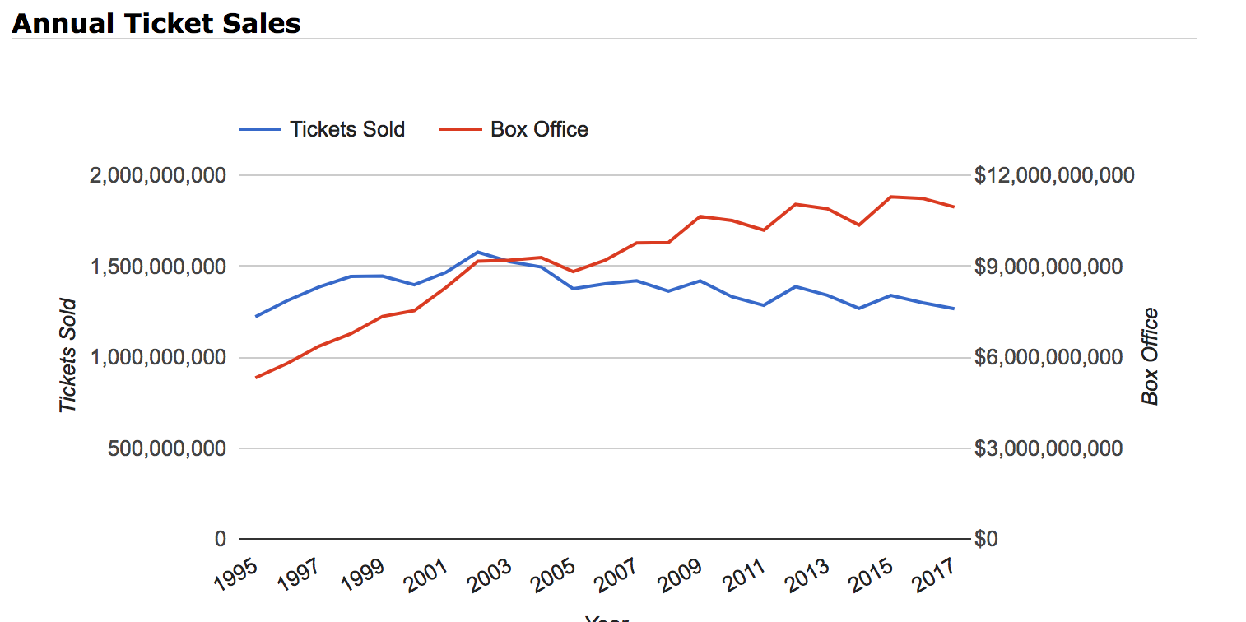
The Truth?

Slide 81
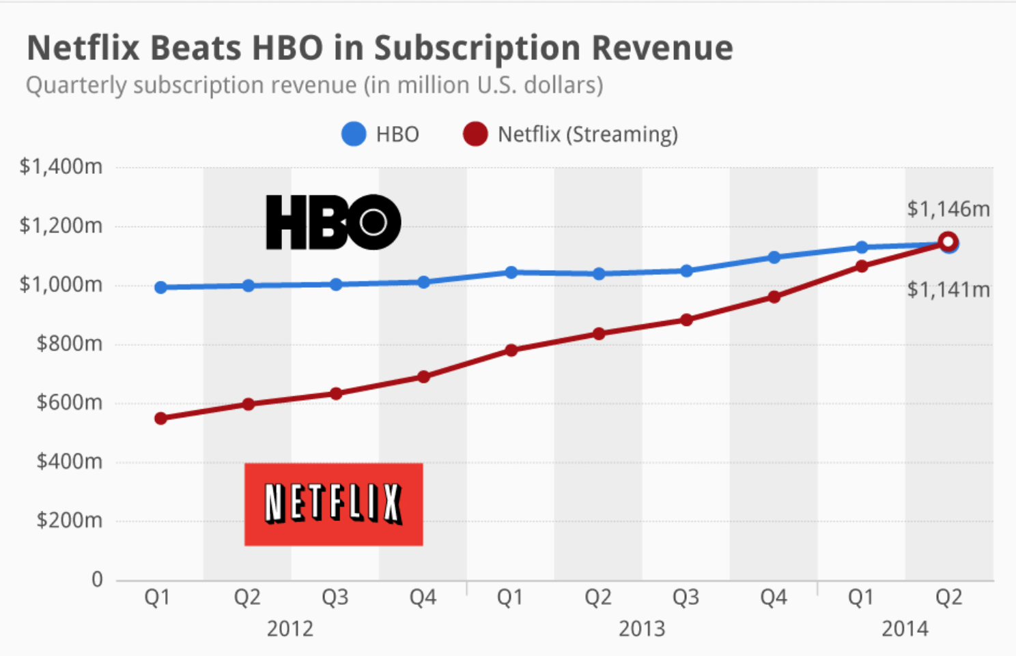
HBO Netflix

Slide 82
Sony v. Universal Studios
The question is thus whether the Betamax is capable of commercially significant noninfringing uses ... one potential use of the Betamax plainly satisfies this standard, however it is understood: private, noncommercial time-shifting in the home.
Notes:
La question est donc de savoir si le Betamax est capable d'utilisations licites d'un point de vue commercial ... une utilisation potentielle du Betamax répond manifestement à ce critère, mais il est entendu: le décalage temporel privé (time-shifting) et non commercial à la maison.

Slide 83
Restrictions of Judges in Common Law Framework
The judiciary’s reluctance to expand the protections afforded by the copyright without explicit legislative guidance is a recurring theme. …Sound policy, as well as history, supports our consistent deference to Congress when major technological innovations alter the market for copyrighted materials.
Notes:
“La réticence du pouvoir judiciaire à étendre les protections offertes par le droit d'auteur sans directives législatives explicites est une récurrence. ...
Une politique saine, ainsi que l'histoire, soutiennent notre déférence constante envers le Congrès lorsque de grandes innovations technologiques modifient le marché des matériaux protégés par le droit d'auteur. ...
Sony Corp v Universal City Studios, Inc SC 464 US 417 (1984).

Slide 84
Sony v Universal Studios
…In a case like this, in which Congress has not plainly marked our course, we must be circumspect in construing the scope of right created by a legislative enactment which never contemplated such a calculus of interest.
Sony Corp v Universal City Studios, Inc SC 464 US 417 (1984).
Notes:
Dans un cas comme celui-ci, où le Congrès n'a pas nettement marqué notre cours, nous devons être circonspects dans l'interprétation de la portée du droit créé par un texte législatif qui n'a jamais envisagé un tel calcul d'intérêt.”

Slide 85
A Misapplication of Law by the Judges? By the Prosecution?
Notes:
Gone astray – devoyés, égarés
Une application de la loi un pas trop loin? Droit jurisprudentiel erroné?

Slide 86
Patent law in Copyright?
The Copyright Act does not expressly render anyone liable for infringement committed by another. In contrast, the Paten Act expressly brands anyone who “actively induces infringement of a patent” as an infringer, 35 USC §271(b).
We observe…that reasoned analysis of respondents’ unprecedented …claim necessarily entails consideration of arguments and case law which may also be forwarded under the other labels…[e.g., Patent].
Notes:
La loi de copyright ne sanctionne pas la contrefaçon indirecte
Les juges appliquent d’autres principes de PI (le brevet)
“La Loi sur le droit d'auteur ne rend pas expressément responsable les infractions d’un tiers.
En revanche, la loi sur les brevets s’applique à nomme expressément toute personne qui encourage de maniere directe ou indirecte, la contrefaçon.
35 USC §271 (b)
PK: This will be very difficult to understand for them. The title should be: “La loi de copyright ne sanctionne pas la contrefaçon indirecte” Drop this slide?
Reject– ecarter, repousser,

