Slide 1

Leo Groarke
Department of Philosophy
Trent University
Multimodal* Arguments
*(multimodal vs. “multi-modal”)

Slide 2
INTRODUCTION

Slide 3
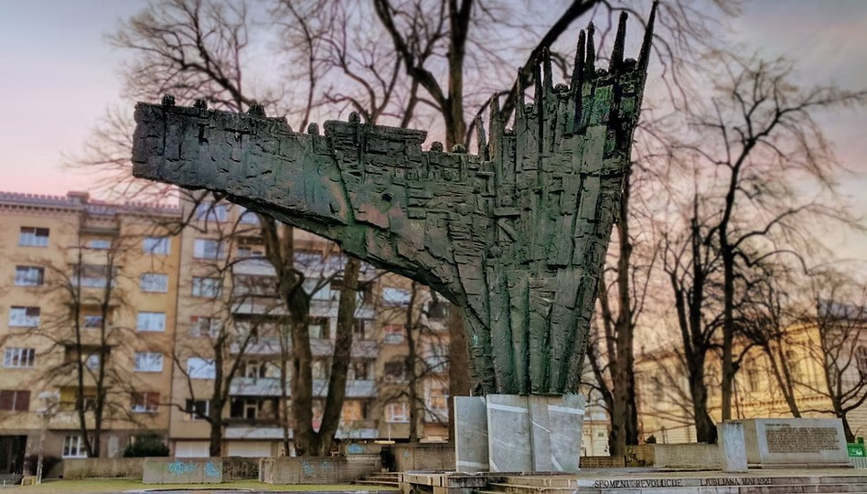
Monument to the Revolution
Drago Tršar, Vladimir Braco Mušič1975

Slide 4
VISUAL ARGUMENT
REVOLUTION

Slide 5

2025: A REVOLUTION IN THE STUDY OF ARGUMENT

Slide 6
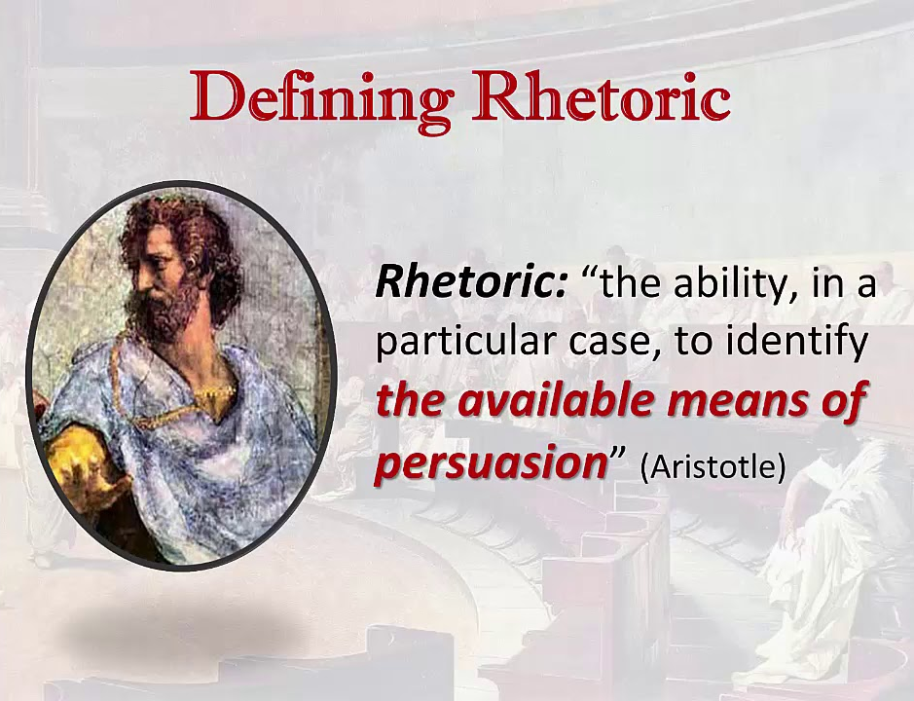
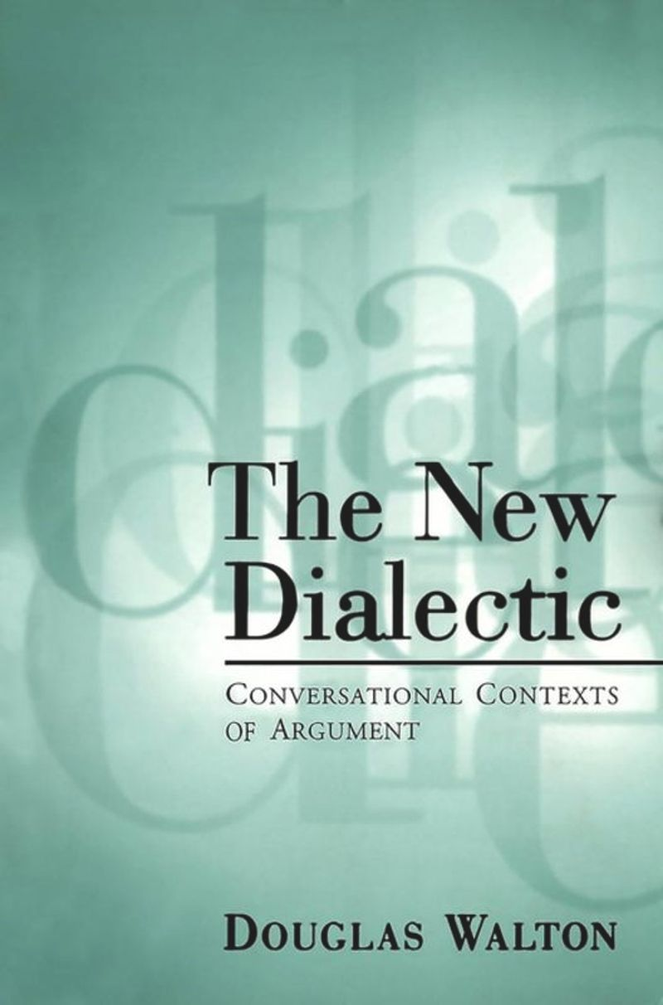

Reason 1

Slide 7

Reason 2

Slide 8
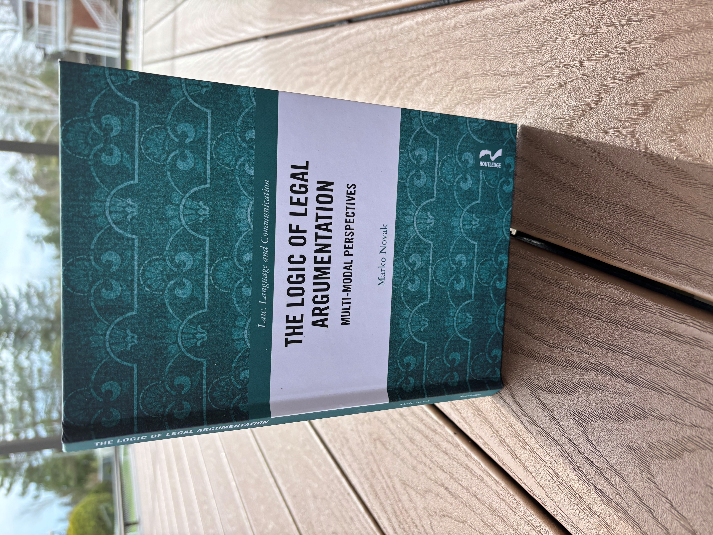
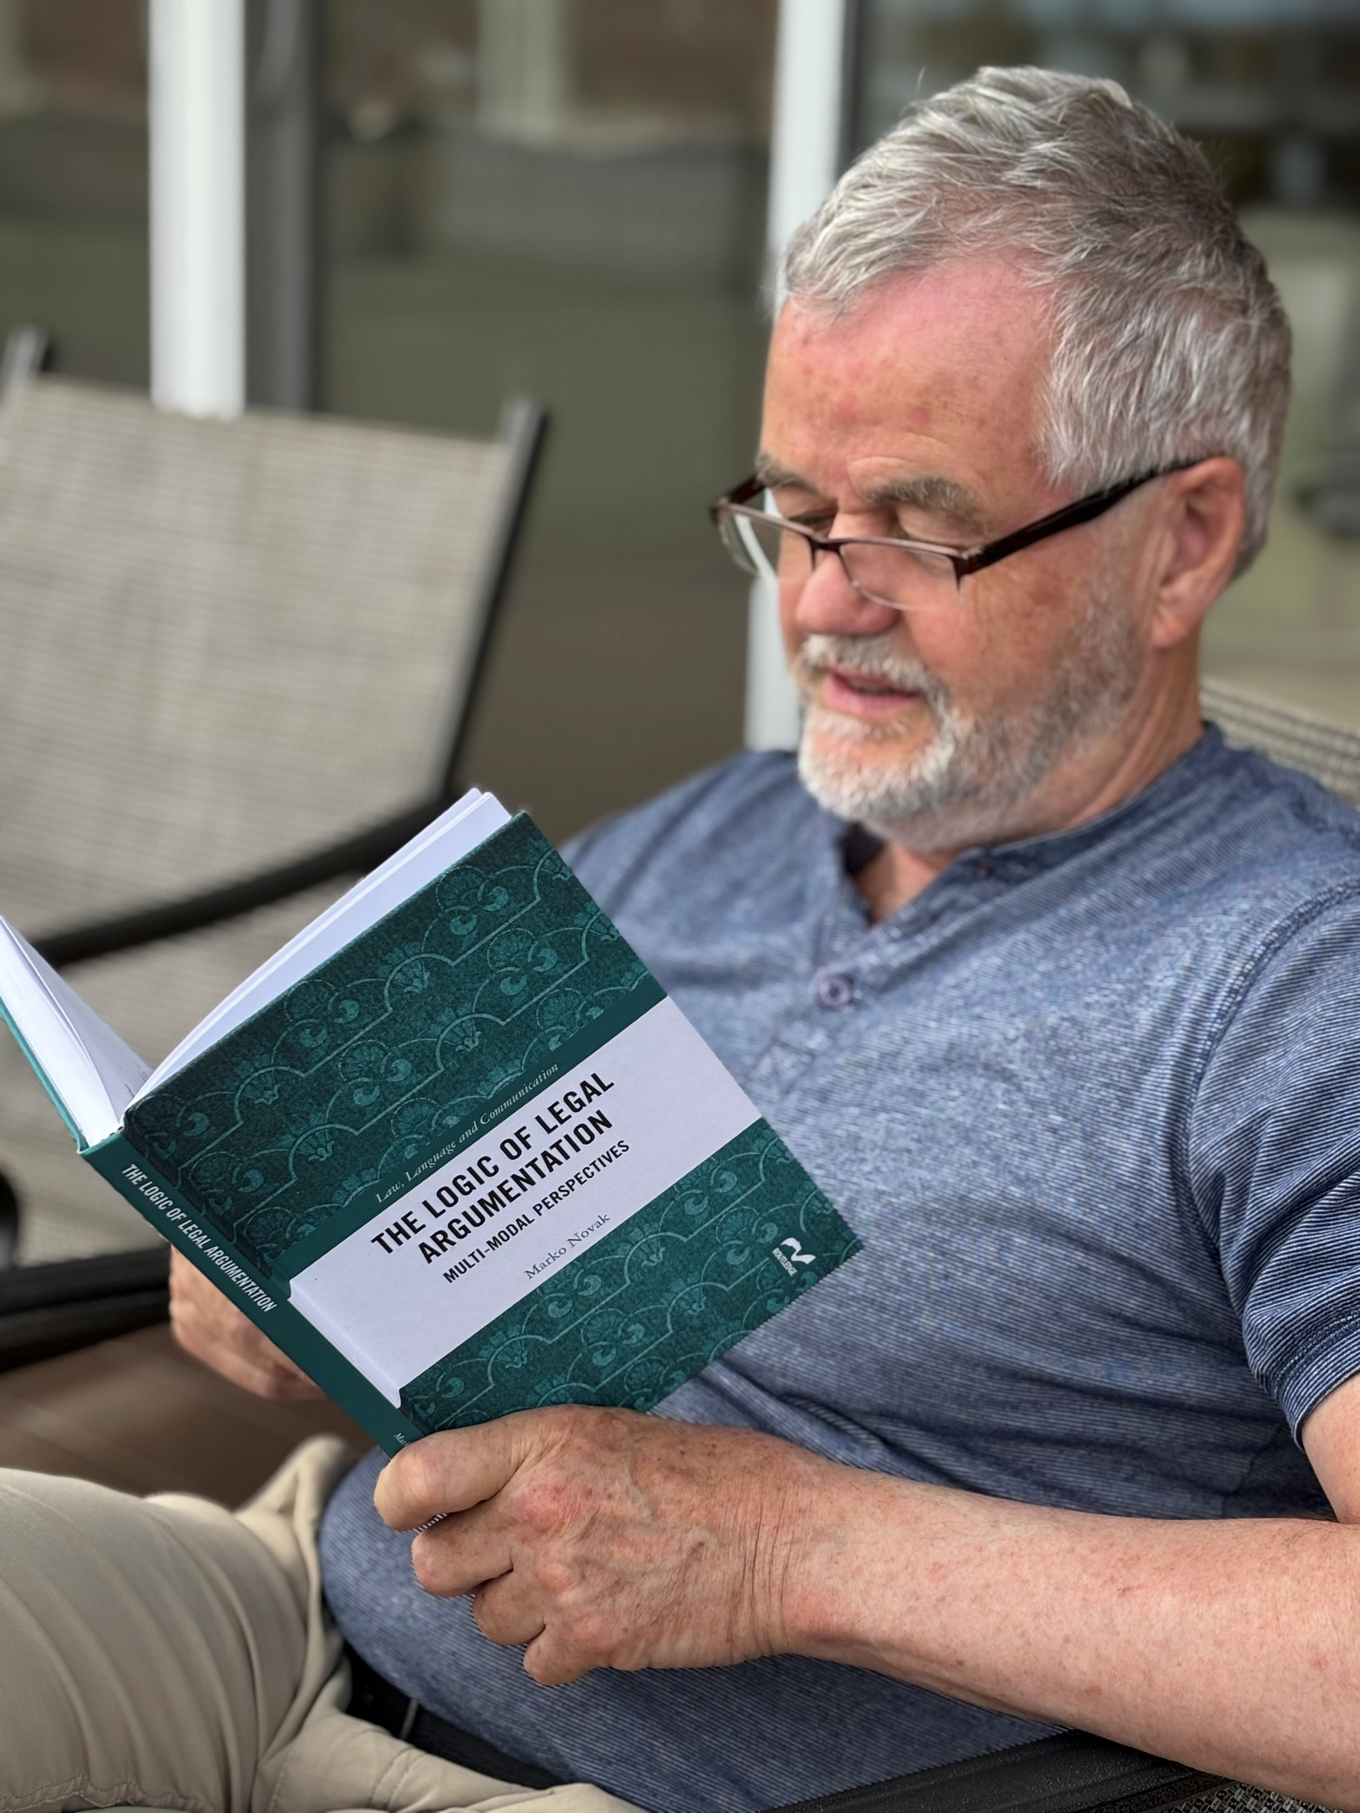
WHERE YOU CAN READ ABOUT THIS:

Slide 9
INTRODUCTION to my approach…

Slide 10

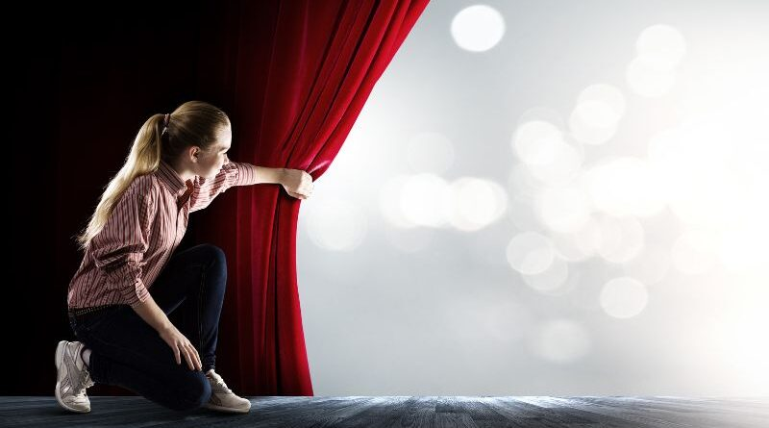
“INFORMAL” Logic and “Critical Thinking”

Slide 11
SHORT BIBLIOGRAPHY
**Puppo, Federico, ed. 2019. Informal Logic: A “Canadian” Approach to Argument. Windsor: Windsor Studies in Argumentation (WSIA), Volume 9.
**Groarke, Leo. 2021. “Informal Logic.” Stanford Encyclopedia of Philosophy. https://plato.stanford.edu/entries/logic-informal/.
***Hitchcock, David. 2022. “Critical Thinking.” Stanford Encyclopedia of Philosophy. https://plato.stanford.edu/entries/critical-thinking/history.html
_____________________________________________________________________________________________________________________________________________________
****Tseronis, Assimakis, and Charles Forceville. 2017. “Argumentation and Rhetoric in Visual and Multimodal Communication.” In Multimodal Argumentation and Rhetoric in Media Genres, edited by Tseronis and Forceville.**

Slide 12
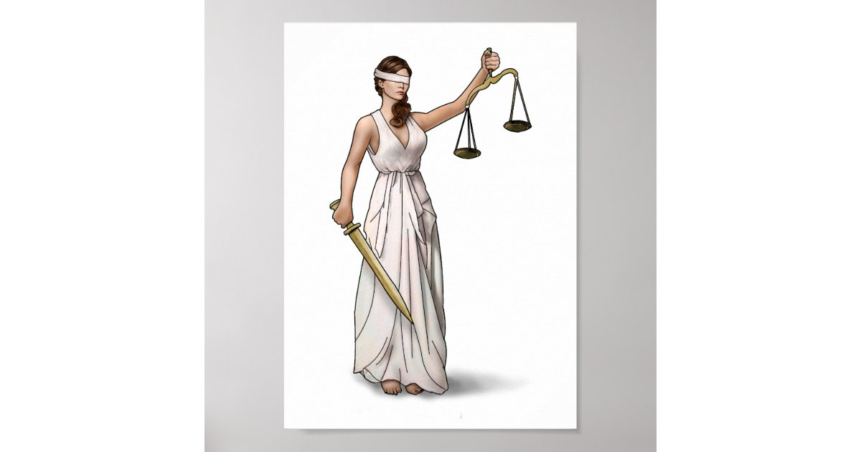
A critical thinker is someone who tests beliefs by considering the strength of the arguments for and against them

Slide 13
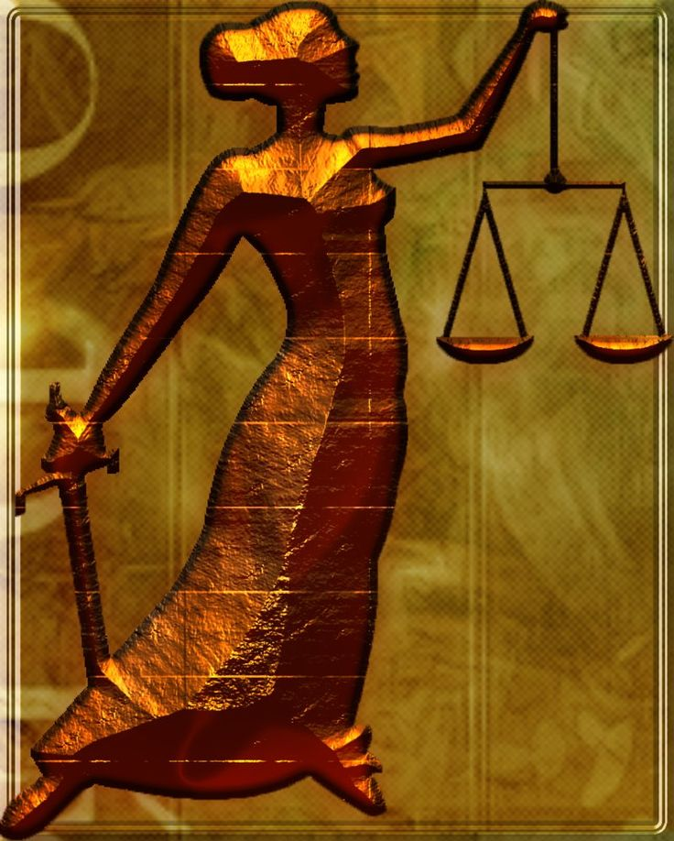

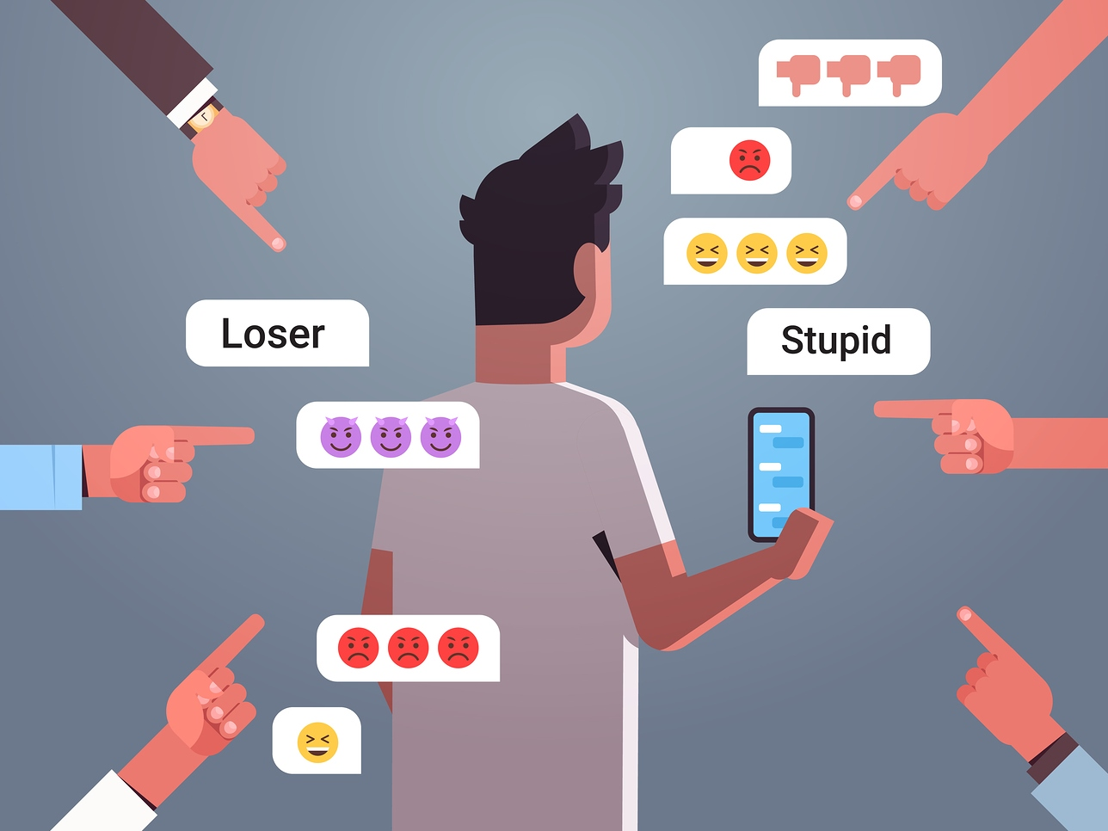
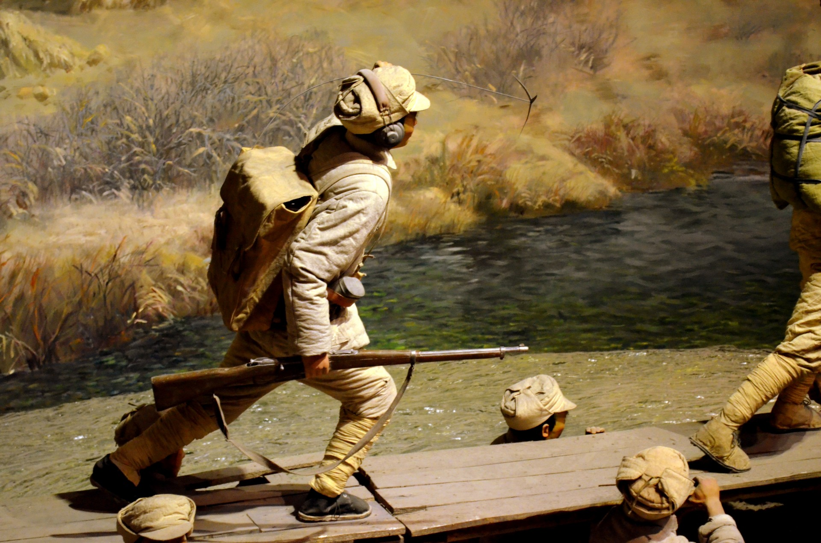
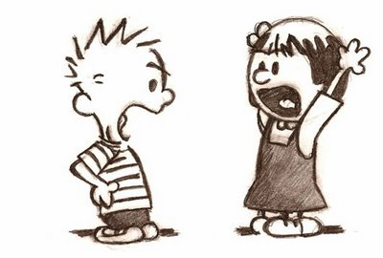
An ARGUMENT is:
(i)an attempt to resolve disagreement by
considering the evidence for (and against)
a point of view.
(ii) evidence is an alternative to social pressure,
popular opinion, self-interest, force, war:

Slide 14
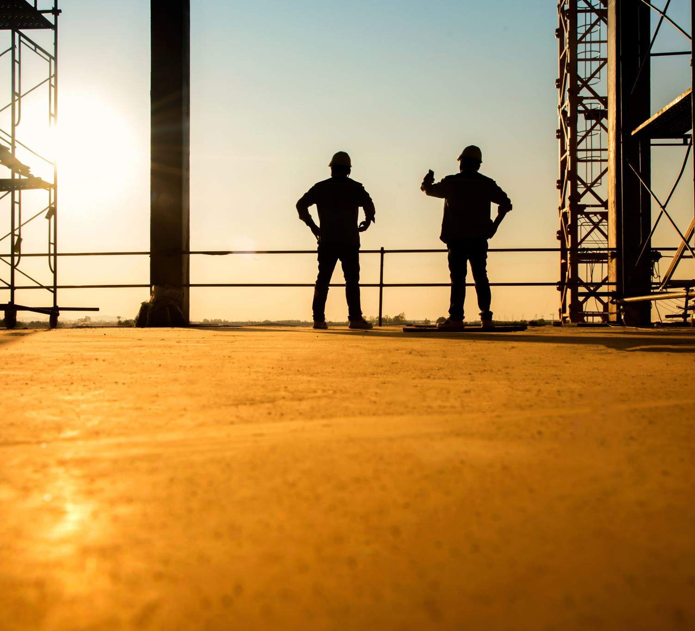
A specific argument consists of:
Reasons (evidence) offered in favour of some point of view

Slide 15

How should we understand this argument from the point of view of: rhetoric, dialectics, and logic? What might need to be considered in each case?

Slide 16
ARGUMENTS AND THEIR PARTS
INTRODUCTION to LOGIC:
PART 1

Slide 17
TWO PARTS OF AN ARGUMENT
(1) Key components (KC): a conclusion
And premise(s)
(2) An inference: from the premises
to the conclusion

Slide 18

KC TABLE

Slide 19


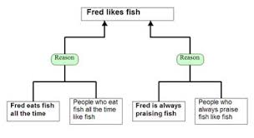
Argument Diagram

Slide 20
EXAMPLE 1
A PHONE CALL:
“There are dark clouds in the sky, so
you should bring your umbrella to work.”

Slide 21
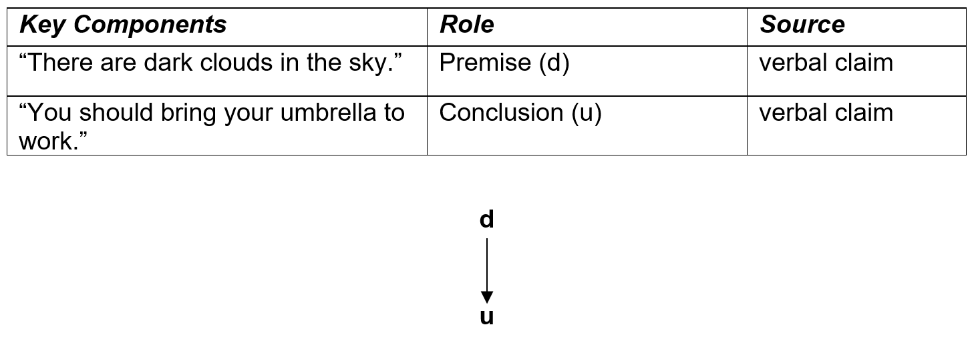
KC TABLE AND DIAGRAM
STANDARDIZED

Slide 22
What are the *4* arguments noted in the following passage?

Slide 23
Since 2015, the Slovenian government has been erecting a barbed wire fence along its southern border in an attempt to stem the flow of migrants from neighboring Croatia. Residents of nearby Slovenian villages are not happy about the barrier…
"Who likes waking up in the morning to barbed wire outside their window?“ "They say this fence was made to protect us ... but to protect us from what?" The retiree, who has lived for years in this still largely wild region, is not at all convinced by the government's argument of a "migratory invasion" to justify the construction of this metal barrier.

Slide 24
"The migrants here, they are passing through, that’s all," he explains. "They transit through Slovenia and then head for other countries, generally to northern Europe.”
Rudy's friends nod their agreement. "They say that the barbed wire will prevent the passage of migrants ... but everyone passes through anyway," says Marco. "For example, right now, with winter and strong [river] currents, the shores are muddy, porous, so the ground is moving, the fence is collapsing. Migrants who want to pass don't even need to exert themselves, they just have to step over it," Marco continues laughing. "There are places where furrows have been made. They can also pass under the barrier!"

Slide 25
the government's argument of a "migratory invasion" to justify the construction of this metal barrier.
Who likes waking up in the morning to barbed wire outside their window?“
protect us from what? They transit through Slovenia and then head for other countries, generally to northern Europe
right now, with winter and strong [river] currents, the shores are muddy, porous, so the ground is moving, the fence is collapsing. Migrants who want to pass don't even need to exert themselves, they just have to step over it,"
"There are places where furrows have been made. They can also pass under the barrier!"
They say that the barbed wire will prevent the passage of migrants ... but everyone passes through…

Slide 26
ARGUMENT EVALUATION
INTRODUCTION to LOGIC:
PART 2

Slide 27
AN EXAMPLE: A LETTER TO A NEWSPAPER
Better face reality. The world economy will be a mess in the future. If the nations of the world take drastic action to reduce emissions, that will lead to negative economic disruptions, job losses and a higher cost of living.
If they continue business as usual, the effects of climate change will lead negative economic disruptions, job losses and a higher cost of living.
No matter what, there will be economic disruption, job losses and a higher cost of living.

Slide 28
What is the argument?
How should it be standardized?

Slide 29
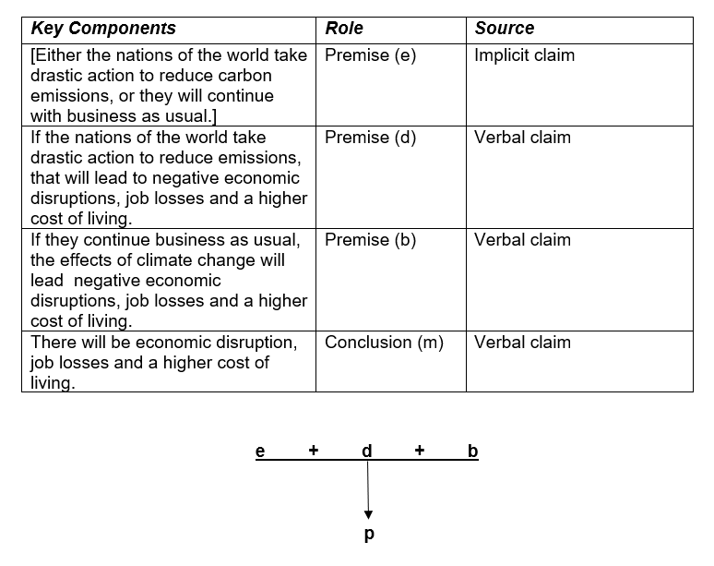
STANDARDIZED

Slide 30
2 CRITICAL QUESTIONS
1. Are the premises of the
argument acceptable?
2. Does the conclusion follow?

Slide 31
1. ACCEPTABILITY
Truth, but not just truth…
Emotional acceptability
Visceral acceptability
Kisceral acceptability

Slide 32
2. Validity
Argumentation Schemes

Slide 33
2. The Argument Scheme
“Dilemma”
1. X or Y.
2. If X, then Z.
3. If Y, then Z.
(THEREFORE)
4. Z.

Slide 34
X = The nations of the world take drastic action to reduce carbon emissions.
A valid instance of “Dilemma”
1. X or Y.
2. If X, then Z.
3. If Y, then W.
(THEREFORE)
4. Z.
Y = They will continue with business as usual.
Z = There will be economic disruption, job losses and a higher cost of living.

Slide 35





INTRODUCTION to MULTIMODAL LOGIC

Slide 36
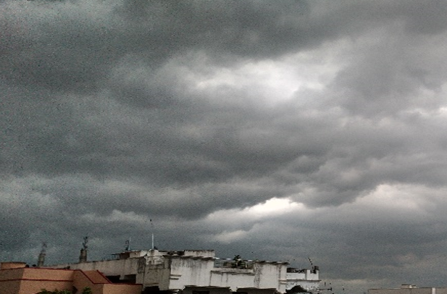

Example 2
View from my office, better bring an umbrella to work!

Slide 37
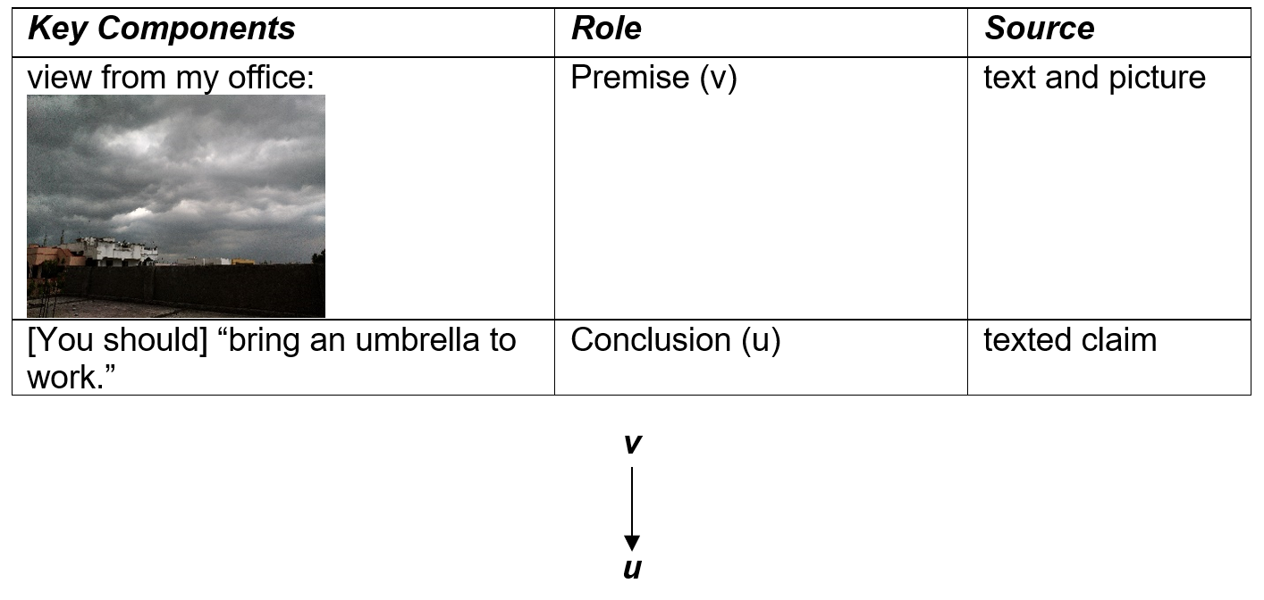
STANDARDIZED

Slide 38
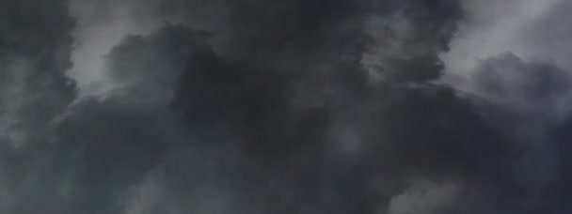

EXAMPLE 3
Someone hears: , points, and says “You better bring an umbrella to work.”

Slide 39
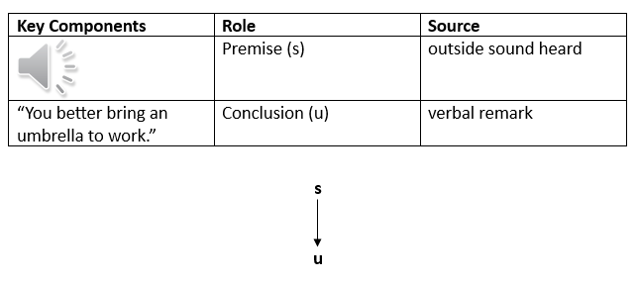
STANDARDIZED

Slide 40
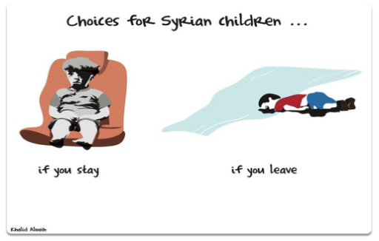
EXAMPLE 4

Slide 41
How would you standardize the argument?

Slide 42
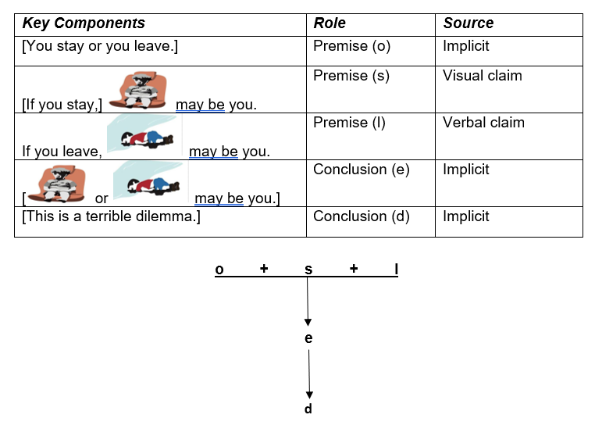
STANDARDIZED

Slide 43
ACCEPTABLE AND VALID?

Slide 44
A VERSION OF DILEMMA
1. X or Y.
2. If X, then Z.
3. If Y, then W.
(THEREFORE)
4. Z or W.

Slide 45
MULTIMODAL ARGUING IS EVERYWHERE

Slide 46
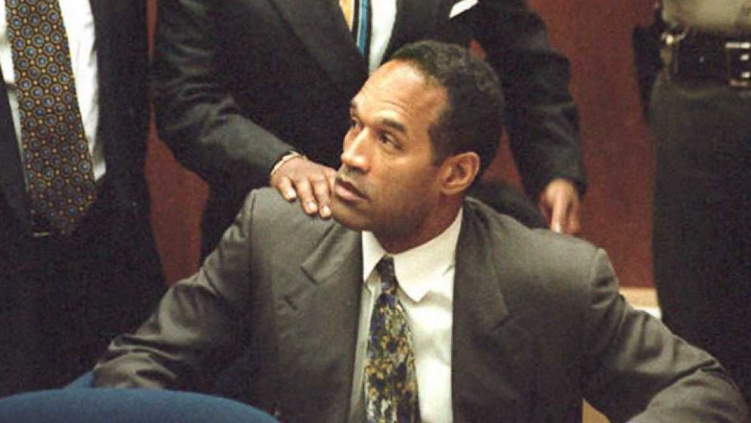
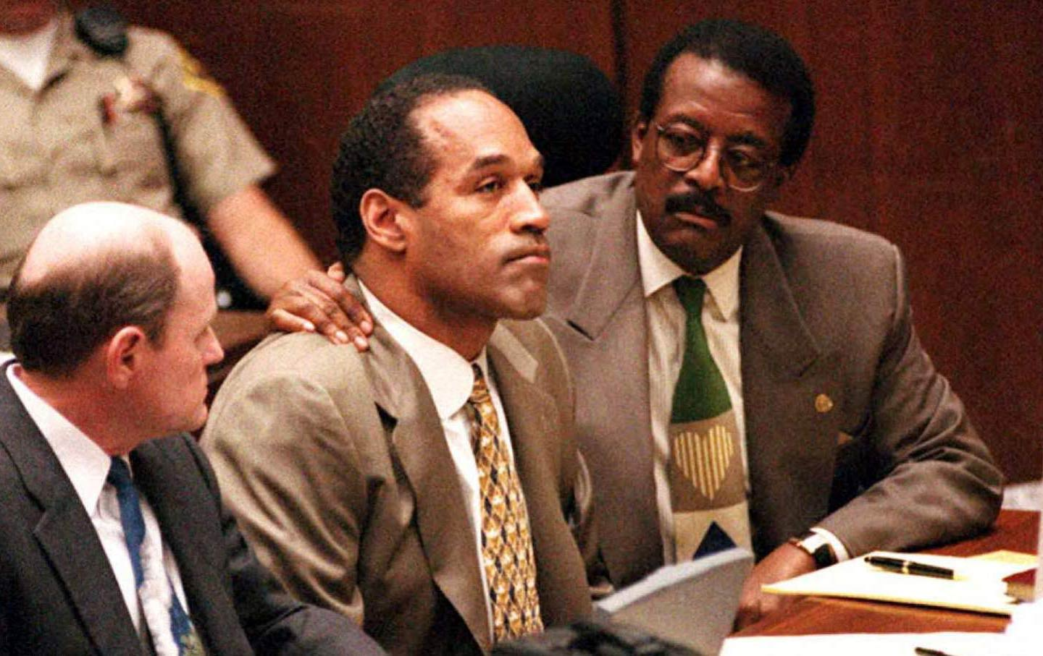
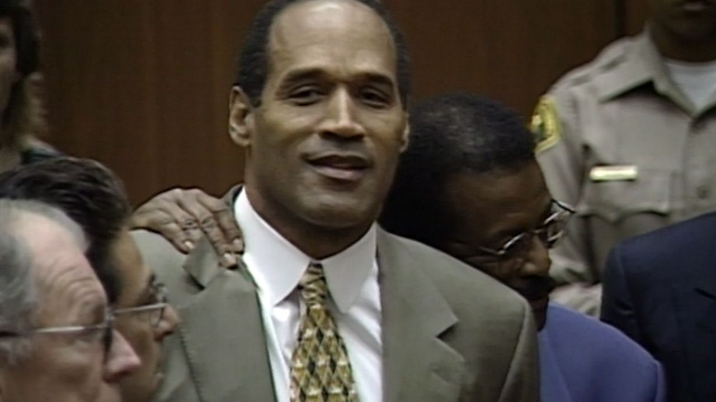
and often missed…

Slide 47
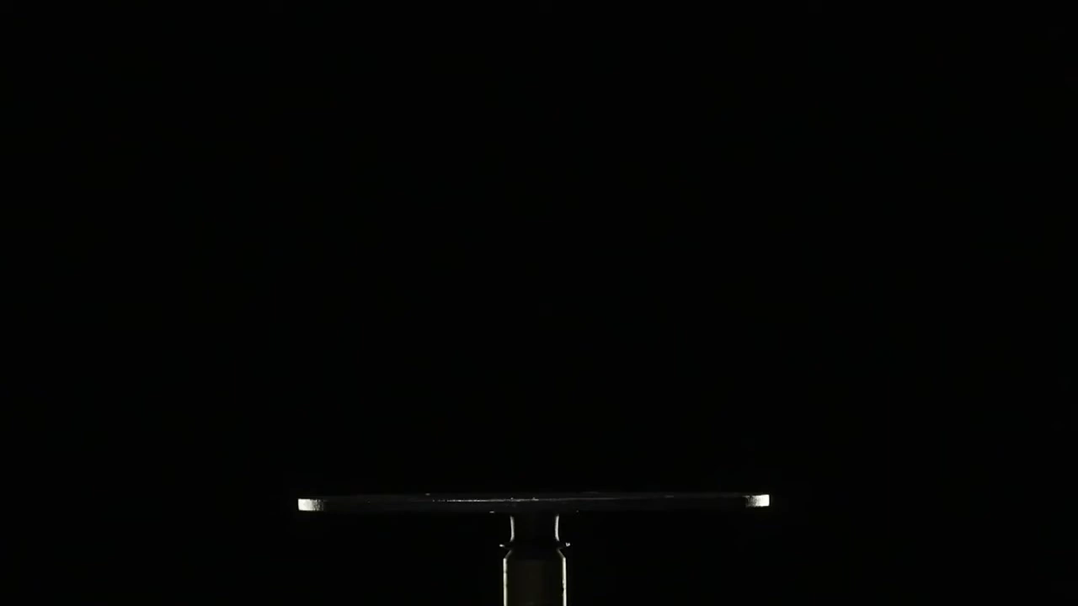
Arguments in advertising

Slide 48
Slovenia’s largest commercial television network, Pop TV, aired an interview with Ivo Boscarol,
a wealthy Slovenian businessman who attended the inauguration celebrations in Washington.
His argument? The Slovenian government had missed a golden opportunity to use Melania’s
presence in the White House to improve its ties with the US….
[T]his thinking… is not grounded in any reality. There is nothing whatsoever in Melania’s memoir to indicate that she has any interest in fostering a political or economic relationship between her adopted country and Slovenia.
The few times she mentioned Slovenia … it was typically a reference to its “totalitarian past”, perhaps playing into the American fear and loathing of communism and socialism.
Melania grew up in the small town of Sevnica and she left to pursue a modelling career before Slovenia gained
independence from Yugoslavia in 1991. She has typically kept quiet about her Slovenian heritage, even though
much of her family still lives here, and she supposedly speaks Slovene with her son. In her speeches,
she has consistently framed the US as the ideal, the place to be, while Slovenia is, well, a place to forget.
Perhaps that’s why she has never seen fit to visit Slovenia during her tenure as first lady. Is that the opportunity Slovenia wants? I amafraid of the neoliberal politicians in power, and the business elites of our country who see any connection – no matter how toxic – as a potential win.
There is no diplomatic gambit to be made, no grand strategic move to consider. Any celebration of Melania in the White House will pass, if it hasn’t already, and with it – luckily – Slovenia’s fleeting hope of leveraging her for political gain. …Slovenia… [will] be better served by focusing on building relationships based on shared values and long-term interests – rather than relying on the whims of problematic individuals.

Slide 49
Monument to the Revolution
Drago Tršar, Vladimir Braco Mušič1975

Slide 50
The emerging conflicts of WWII arrived in Ljubljana when Axis forces invaded Slovenia on April 6th, 1941. At this point, Slovenia was cut up and partitioned between three neighboring Axis countries: Germany, Italy and Hungary. The area of the city of Ljubljana fell within the region annexed by Italy… Italian forces subsequently marched freely into Ljubljana on April 11th, 1941. Italian occupation of the city was harsh and oppressive, which included forced Italianization and heavy-handed military control upon the city (including controlled movement, executions, concentration camps).

Slide 51
The Italian occupiers "wanted to erase the idea of Yugoslav connectedness, primarily by renaming the streets, introducing Italian holidays, [and] tearing down monuments that would remind people of the Kingdom of Yugoslavia." …[T]he people of Ljubljana were not so welcoming as the Italians expected…

Slide 52
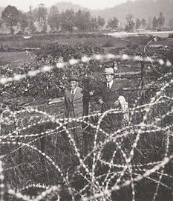

Slide 53
Monument to the Revolution
Drago Tršar, Vladimir Braco Mušič1975

Slide 54
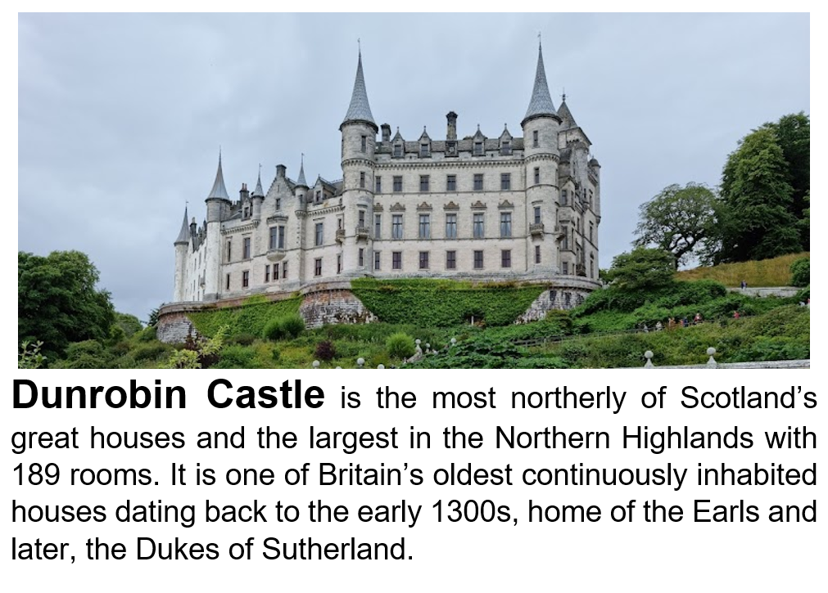
Example

Slide 55
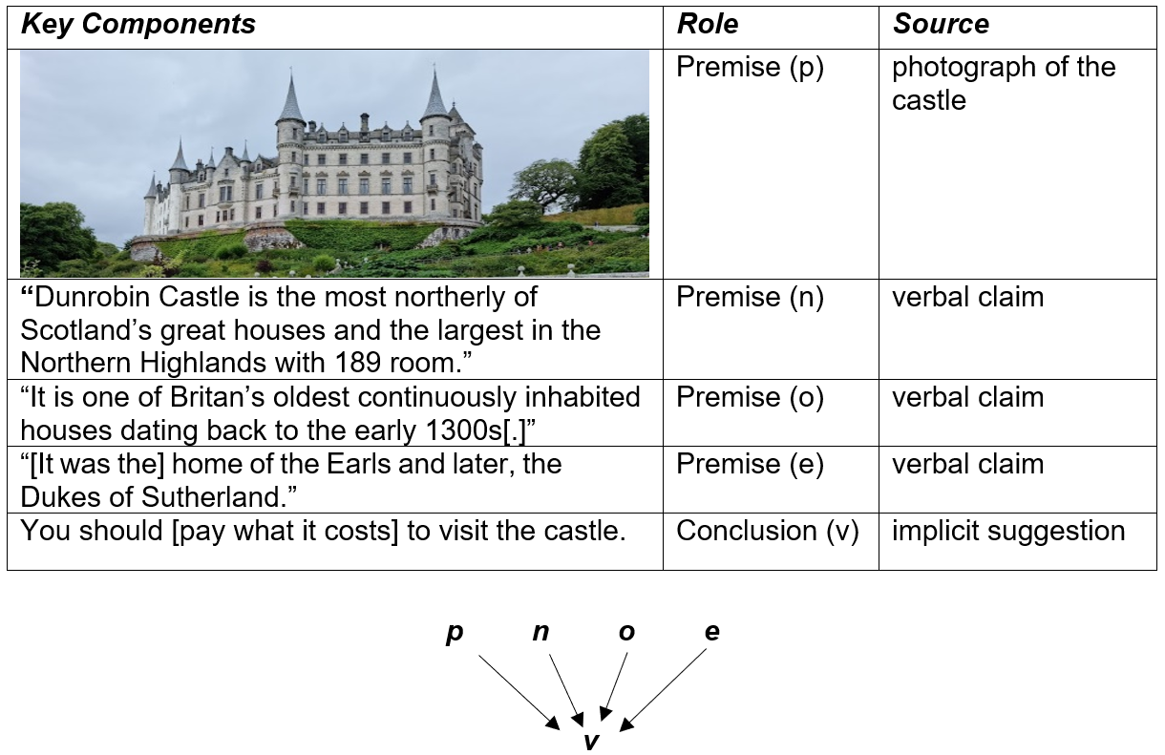

Slide 56
ELECTION ARGUMENTS: Judging People is Multimodal

Slide 57
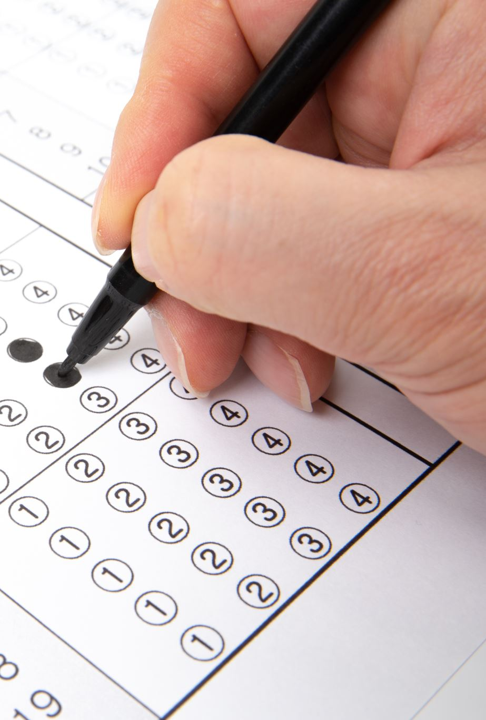
Election Arguments
Judging people is multimodal

Slide 58
►Research shows that we form a first impression of others
in less than one tenth of a second by referring to what we
first notice about them, which is often their face. Human beings develop this tendency as early as 3 years old.
►Argumentative evaluations that are rooted in prosodic features are highly consistent across observers (Oosterhof & Todorov 2008). Rezlescu et al. (2015: 367). They show that our perception of trustworthiness and the credibility of a speaker is highly influenced by vocal cues: “Voices, just like faces, can lead to the formation of consistent trait impressions of trustworthiness, attractiveness, and dominance.” In acts of arguing, arguers may purposefully design their arguments to take advantage of these instinctive judgments.

Slide 59
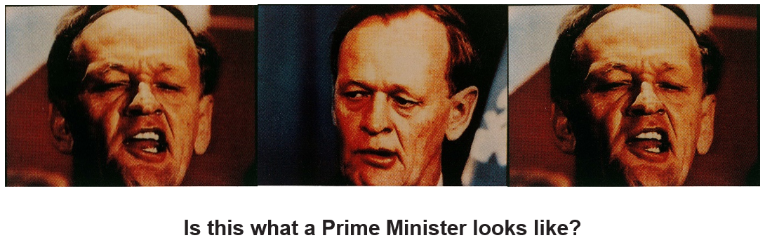

Slide 60
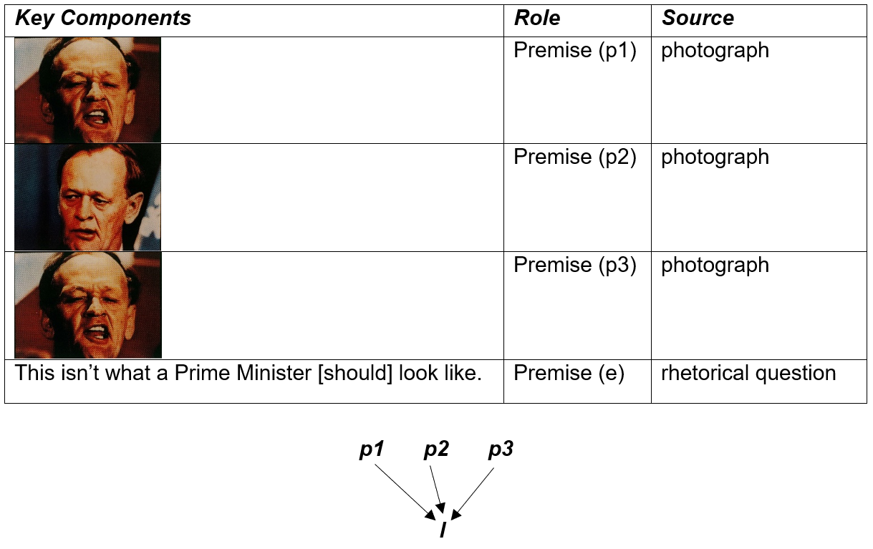

Slide 61
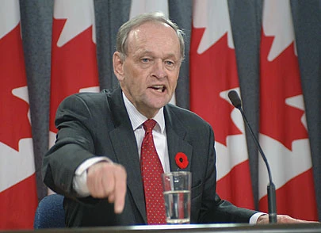
Fallacious Reasoning (A visual equivocation: confusing looking good and being good at what you do.)

Slide 62
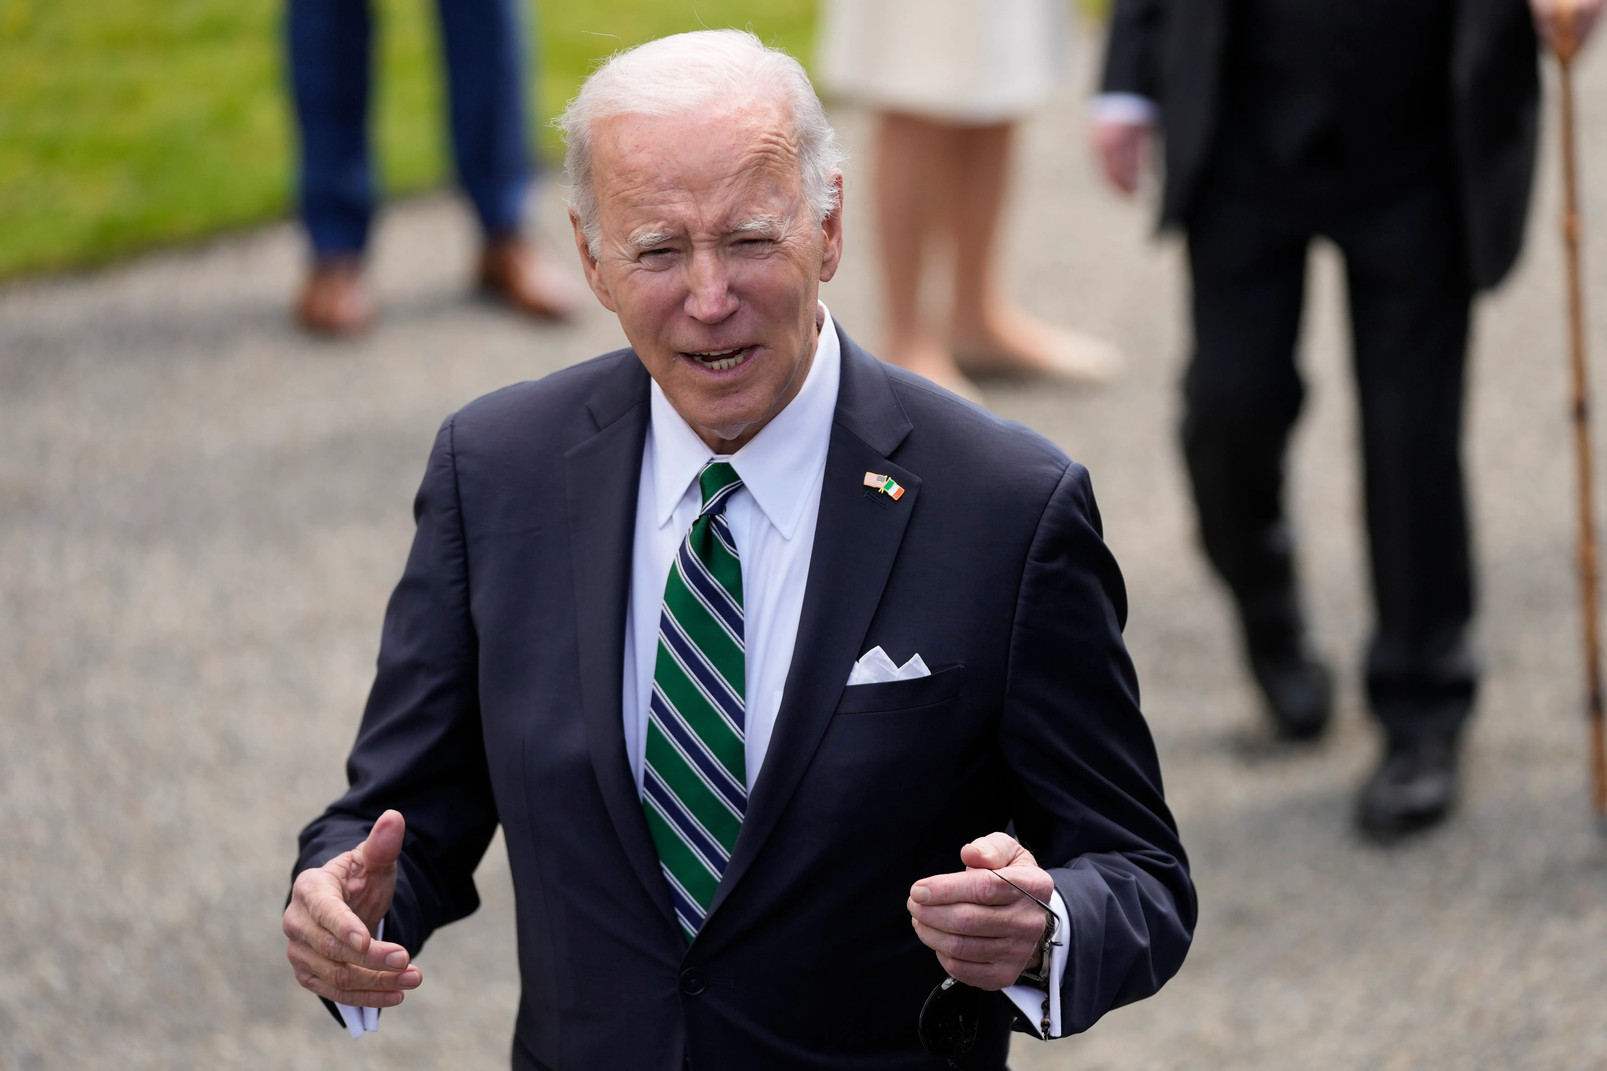
Ad Hominem arguments

Slide 63
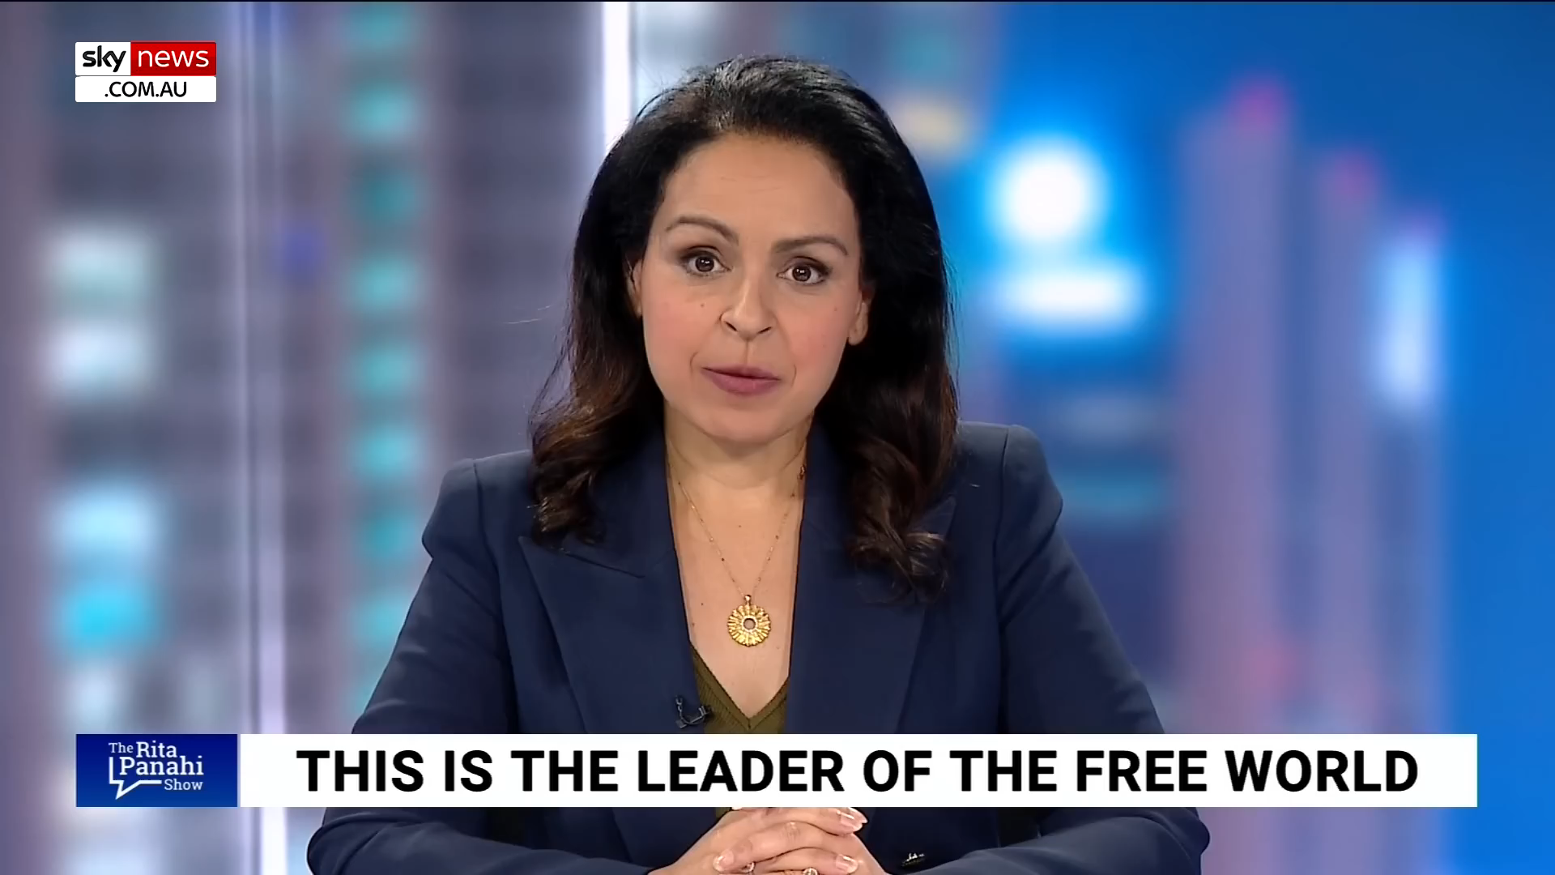

Slide 64
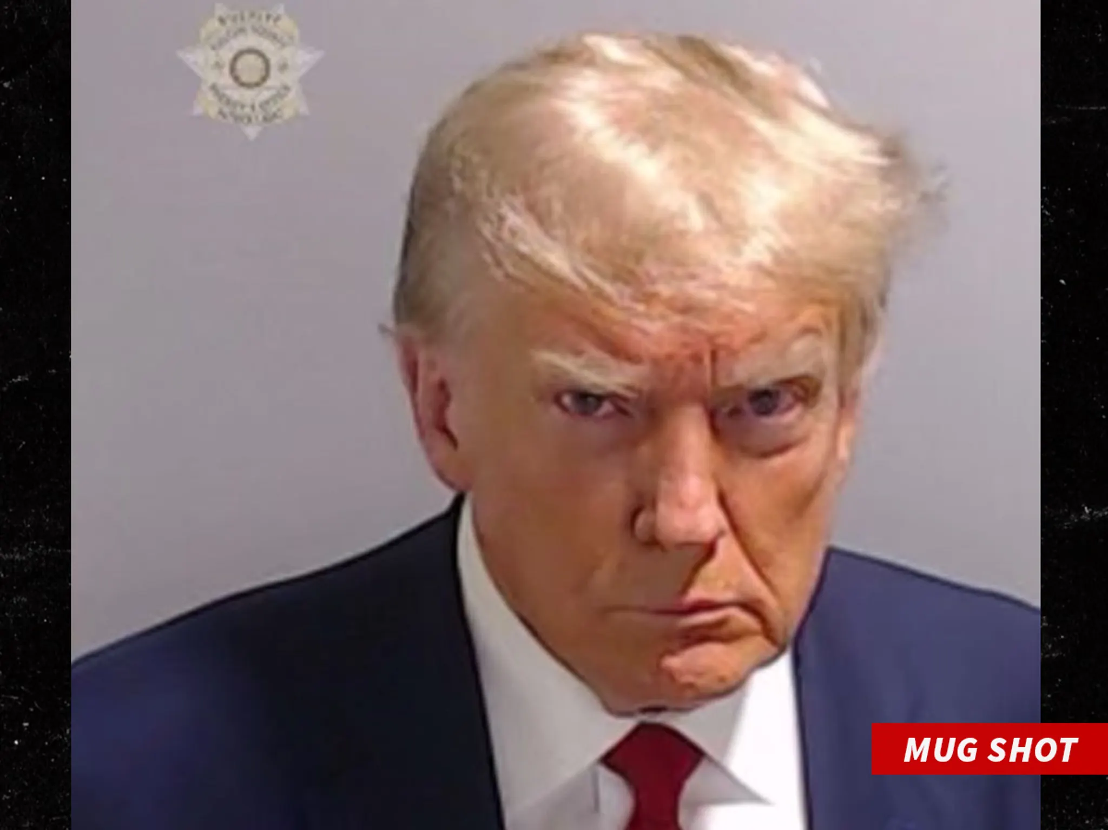
Donald Trump

Slide 65
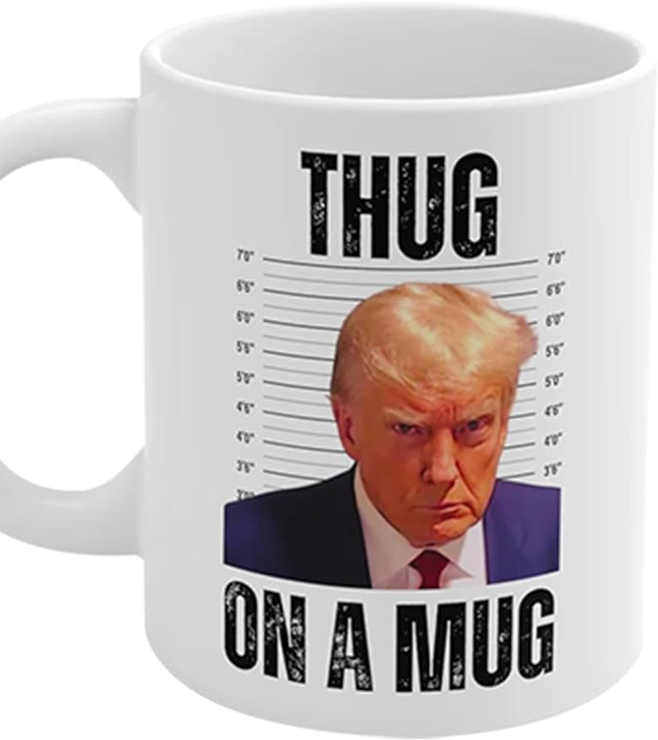

Slide 66
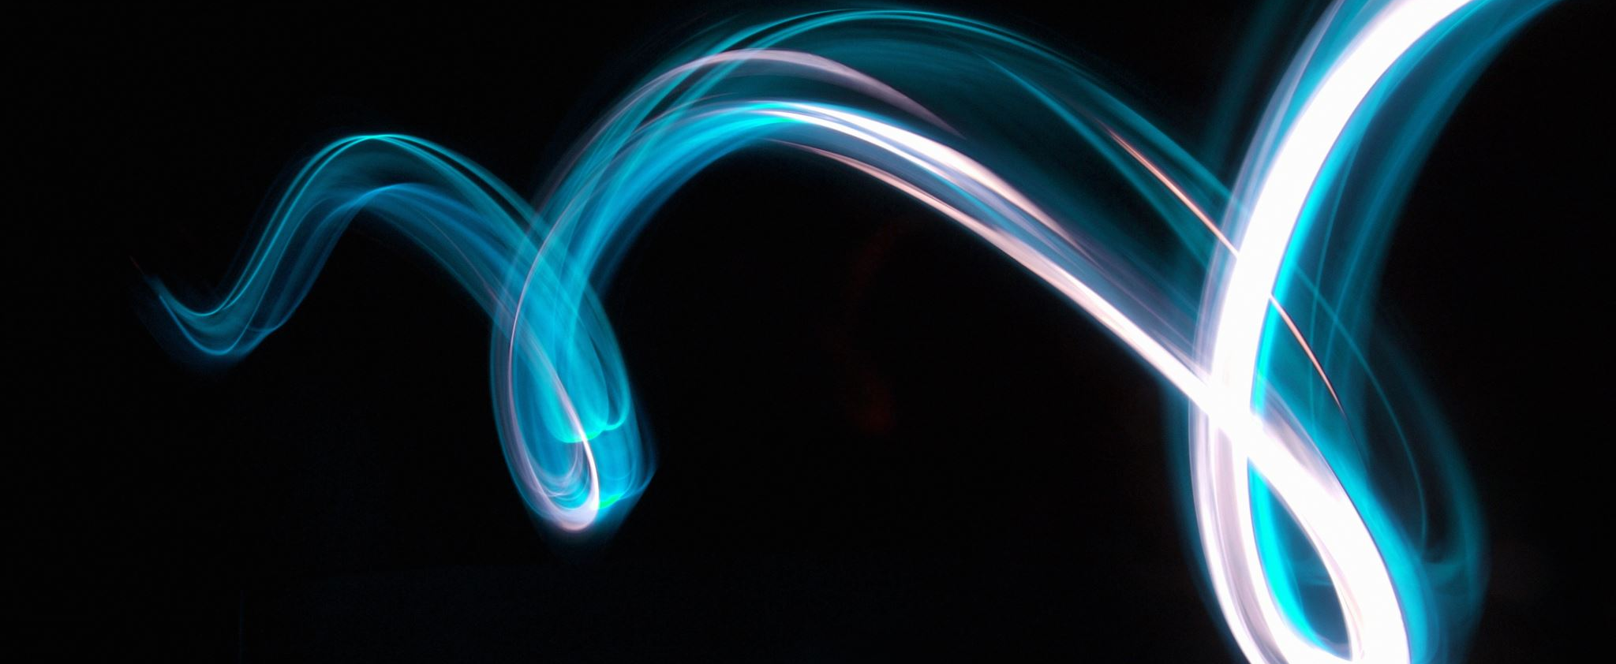
By a peculiar twist of faith…

Slide 67
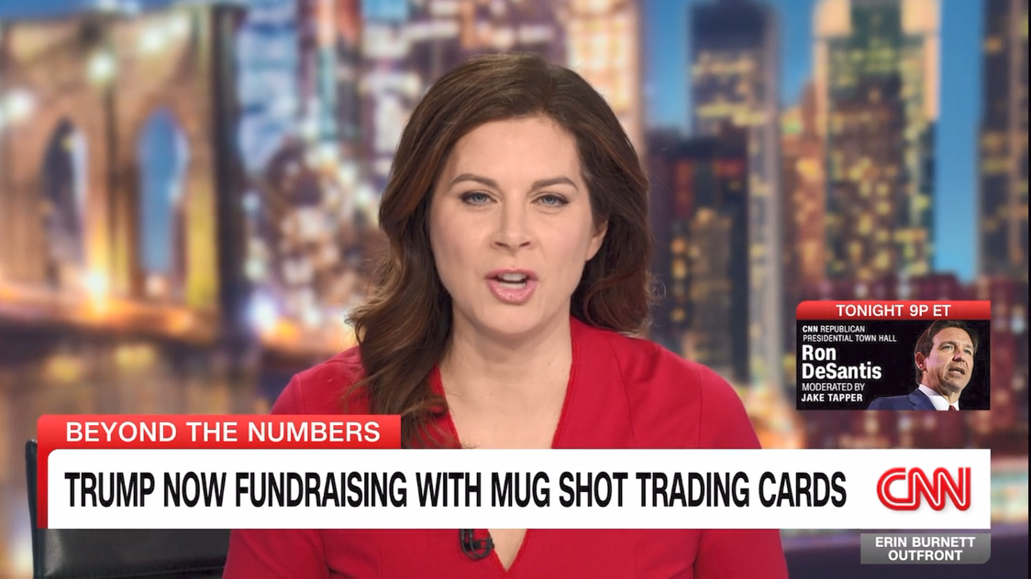
https://www.cnn.com/videos/politics/2023/12/13/trump-fundraising-suit-pieces-cards-enten-ebof-vpx.cnn

