Slide 1
Assessing Visual Arguments:
Toward a Multimodal Logic
Leo Groarke
Trent University

Slide 2
The pre-talk… two simple examples

Slide 3
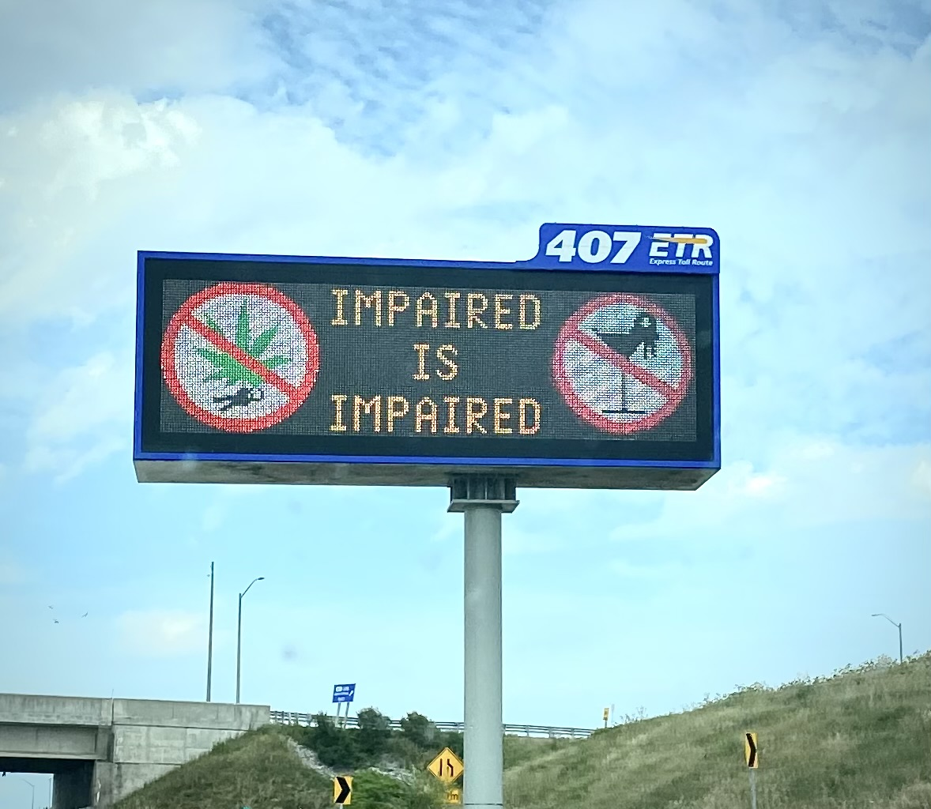

Slide 4
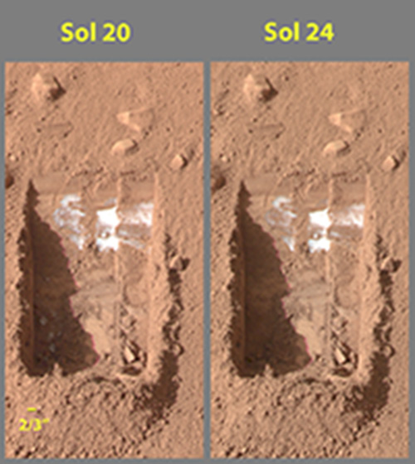

Slide 5
Assessing Visual Arguments:
Toward a Multimodal Logic
Leo Groarke
Trent University

Slide 6
Assessing Visual Arguments:
Toward a Multimodal Logic
Leo Groarke
Trent University

Slide 7
ASSUMPTIONS
There are visual arguments.
There are other (non-verbal) modes of argument (smell, taste, touch, sound, etc.).
Some familiarity with KC tables and argument diagrams.
Groarke, Leo. 2019. “Depicting Visual Arguments: An “ART” Approach.” In Federico Puppo, ed. Informal Logic: A ‘Canadian’ Approach to Argument, pp. 332-374. Windsor: Windsor Studies in Argumentation (WSIA), Vol. 9. <https://windsor.scholarsportal.info/omp/index.php/wsia/catalog/view/123/303/1653-1>

Slide 8
The Key Question Today
Given that there are visual arguments,
how should we assess them –
as logically convincing and unconvincing?

Slide 9
by Intuition(?)

Slide 10
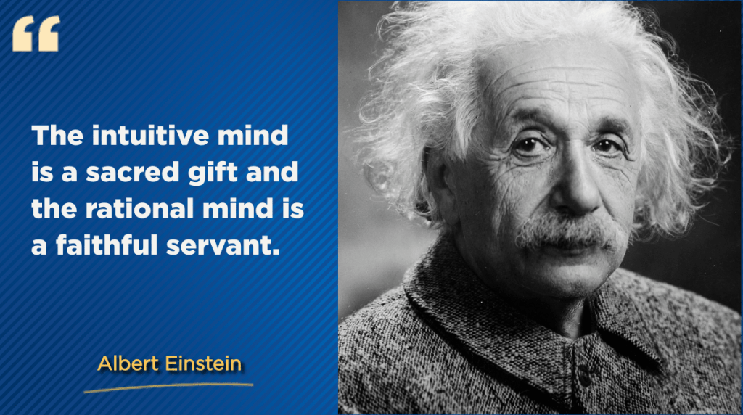

Slide 11
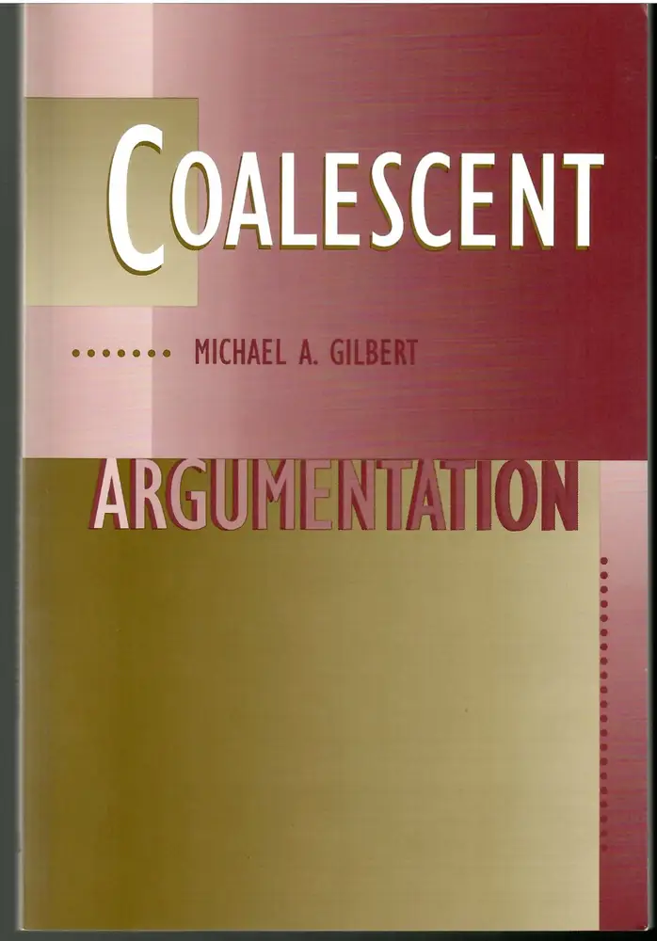
Michael Gilbert?

Slide 12
Sometimes…

Slide 13
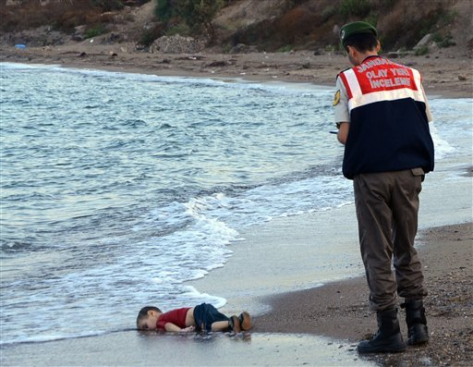
Aylan Kurdi
Photograph

Slide 14
The photo of the dead 3-year-old Syrian boy on a Turkish beach is haunting…
Largely because of social media, the image of little Aylan Kurdi is hammering home the Syrian migrant crisis to the world. Aylan died along with his 5-year-old brother and their mother when their small rubber boat capsized as it headed for Greece.
"It is a very painful picture to view… I had to think hard whether to share this."
But share, he did. Bouckaert, who is in Hungary watching the crisis unfold, said people need to be pushed to view the "ghastly spectacle" … (Business Insider)

Slide 15
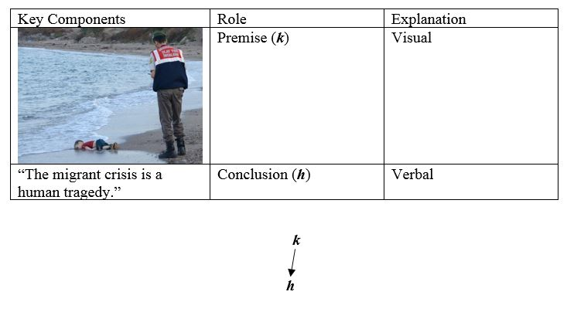
A Visual Argument

Slide 16
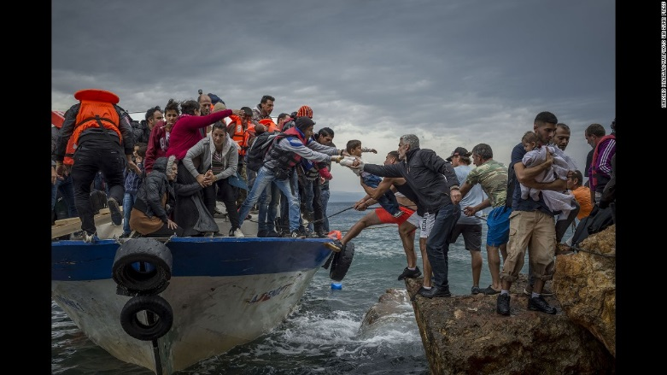
Other
Photographs
(Migrants
Disembarking
In Greece)

Slide 17
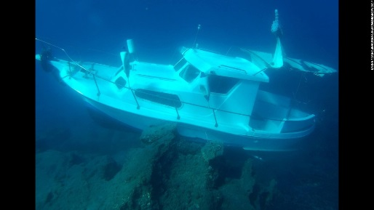
(Sunken
Migrant Boat
off Samos)

Slide 18
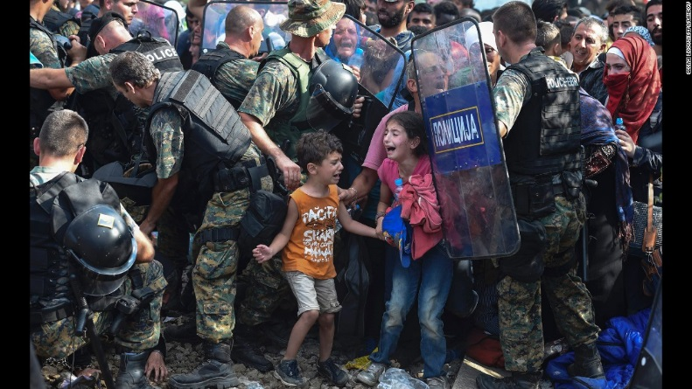
(Migrants crossing into Macedonia)

Slide 19
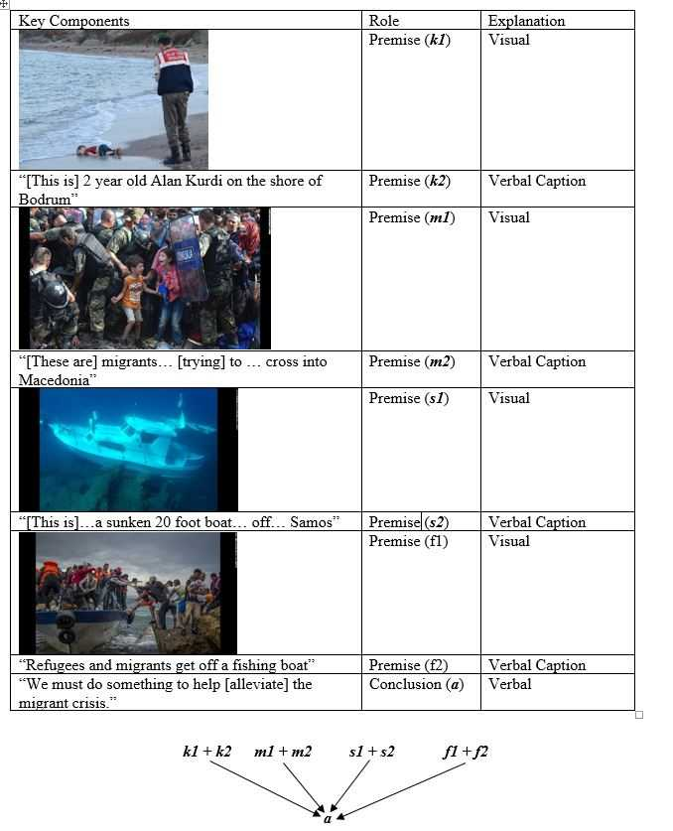
A powerful
visual argument

Slide 20
But intuition has its limits…
How does one decide between conflicting intuitions?
What happens when one doesn’t have intuitions to apply?
How does one explain mistakes?
Unsystematic

Slide 21
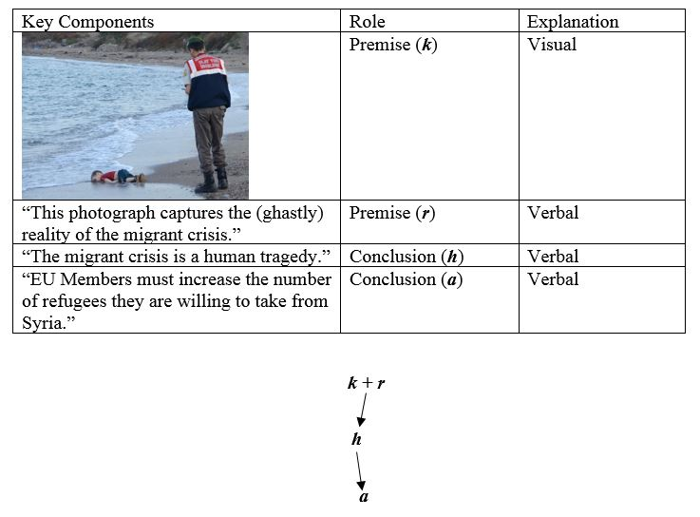
Disagreements
arise even when
intuitions are
strong

Slide 22

Arguments
pro and con

Slide 23
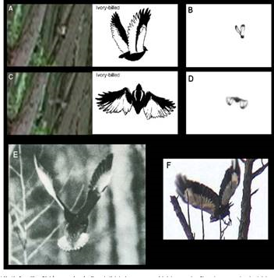
The Ivory Bill
Woodpecker
Debate

Slide 24
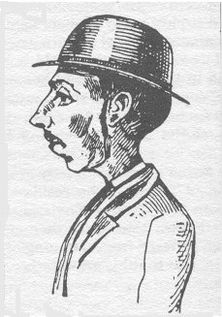
A FORENSIC SKETCH is a visual conclusion…
(1881, Percy Lefroy Mapleton)
How do intuitions apply? Does this look like a murderer?

Slide 25
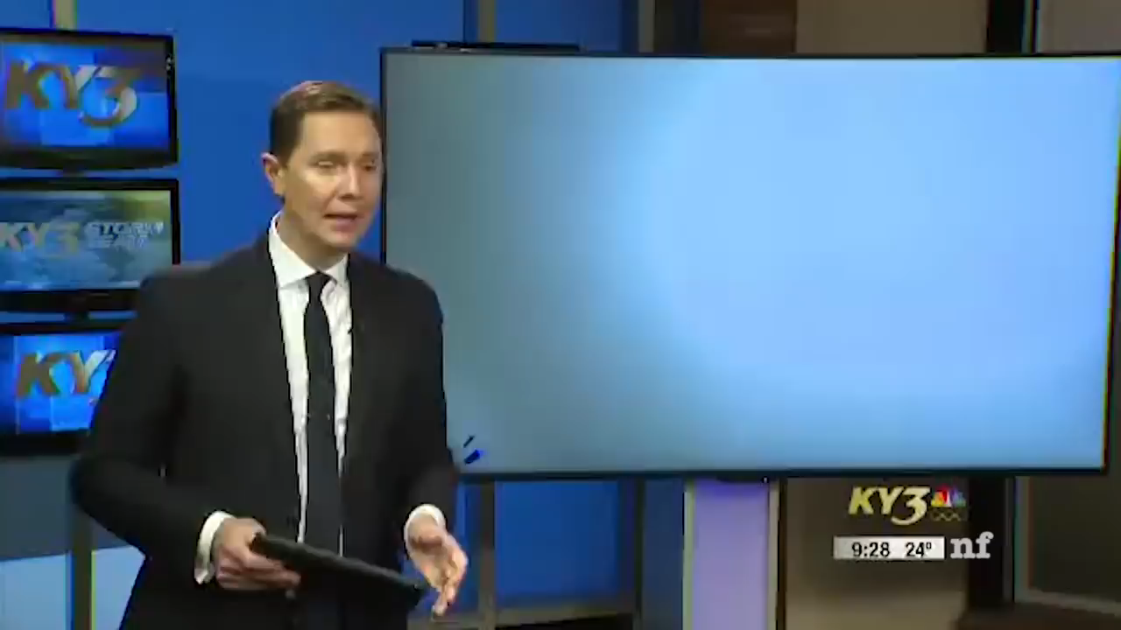

Slide 26
Many other examples…

Slide 27
APPLYING LOGIC’S STANDARDS OF EVALUATION

Slide 28
NOT JUST INTUITIVELY POWERFUL, BUT Valid WITH ACCEPTABLE PREMISES (OR NOT)
1. Does the (possibly visual) conclusion follow from the (possibly visual) premises?
2. Are the (visual, verbal, etc.) premises true/acceptable/etc.?

Slide 29
2. Valid
and Sound

Slide 30
Disagreements
arise even when
intuitions are
strong

Slide 31
Argument schemes

Slide 32
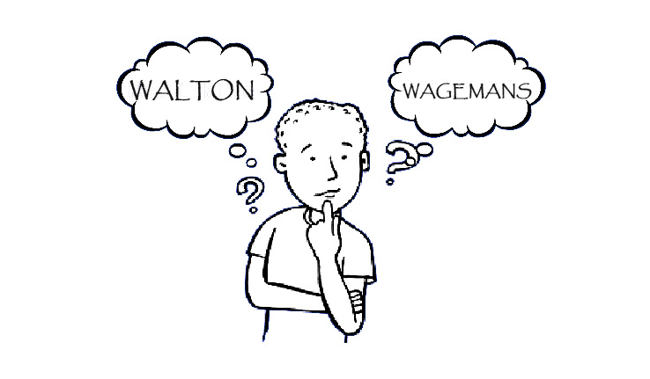
Two Standard Approaches

Slide 33
PLUS A Third (More Visual) Approach …
Dove, Ian J. 2016. Visual Scheming: Assessing Visual Arguments. Argumentation and Advocacy, 53,3. Third Special Issue on Visual Argument: 254-264.
Groarke, Leo 2017. “Editorial Cartoons and ART: Arguing with Pinocchio,” in Tseronis & Forceville, eds. 2017 Multimodal Argumentation and Rhetoric in Media Genres.
Groarke, Leo. (2019). “Matching schemes of argument: Verbal, visual, multimodal,” in Bart Garssen, David Godden, Gordon R. Mitchell, Jean H.M. Wagemans (Eds.) Proceedings of the Ninth Conference of the International Society for the Study of Argumentation. Amsterdam: Sic Sat 2019.

Slide 34
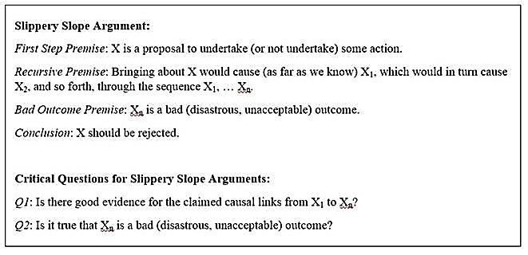
A Standard (Walton) Scheme…

Slide 35
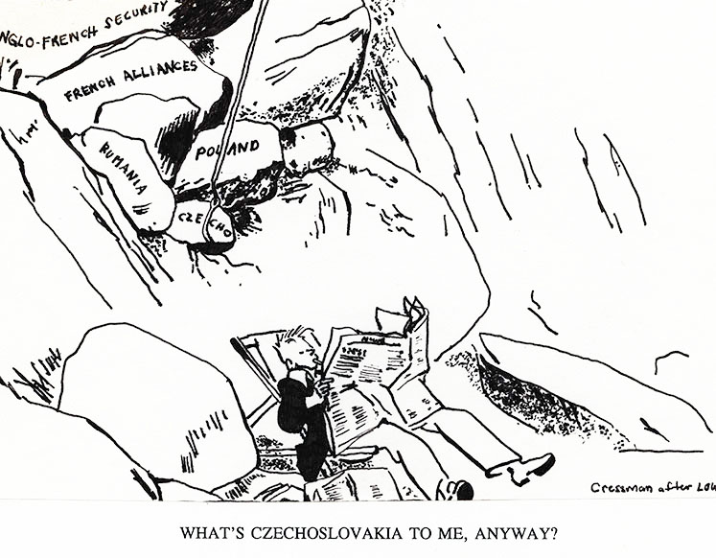
World War II
cartoon
(Sir David Low)

Slide 36
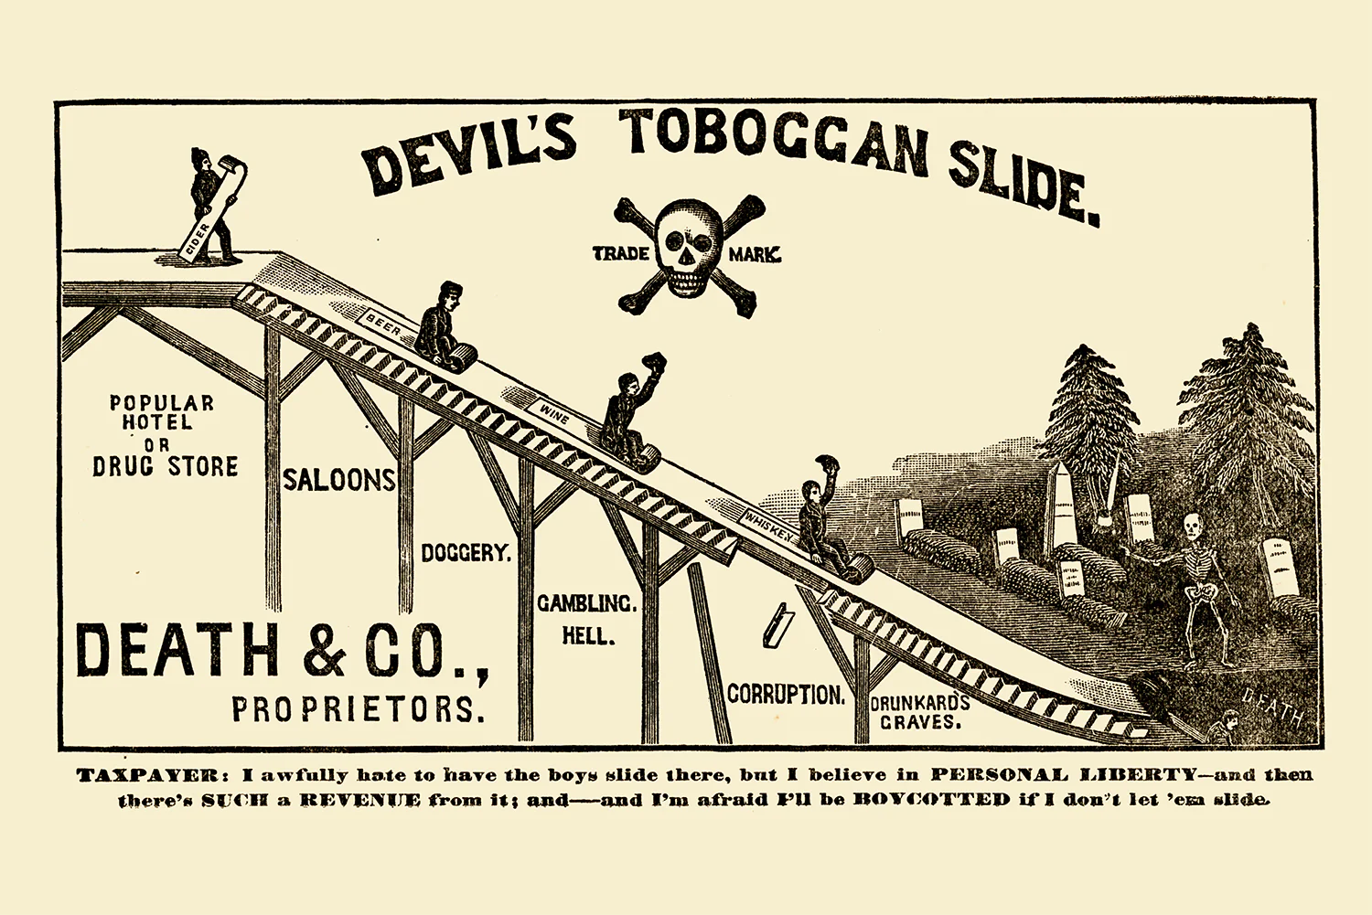
American
Anti-alcohol
poster, 1886

Slide 37
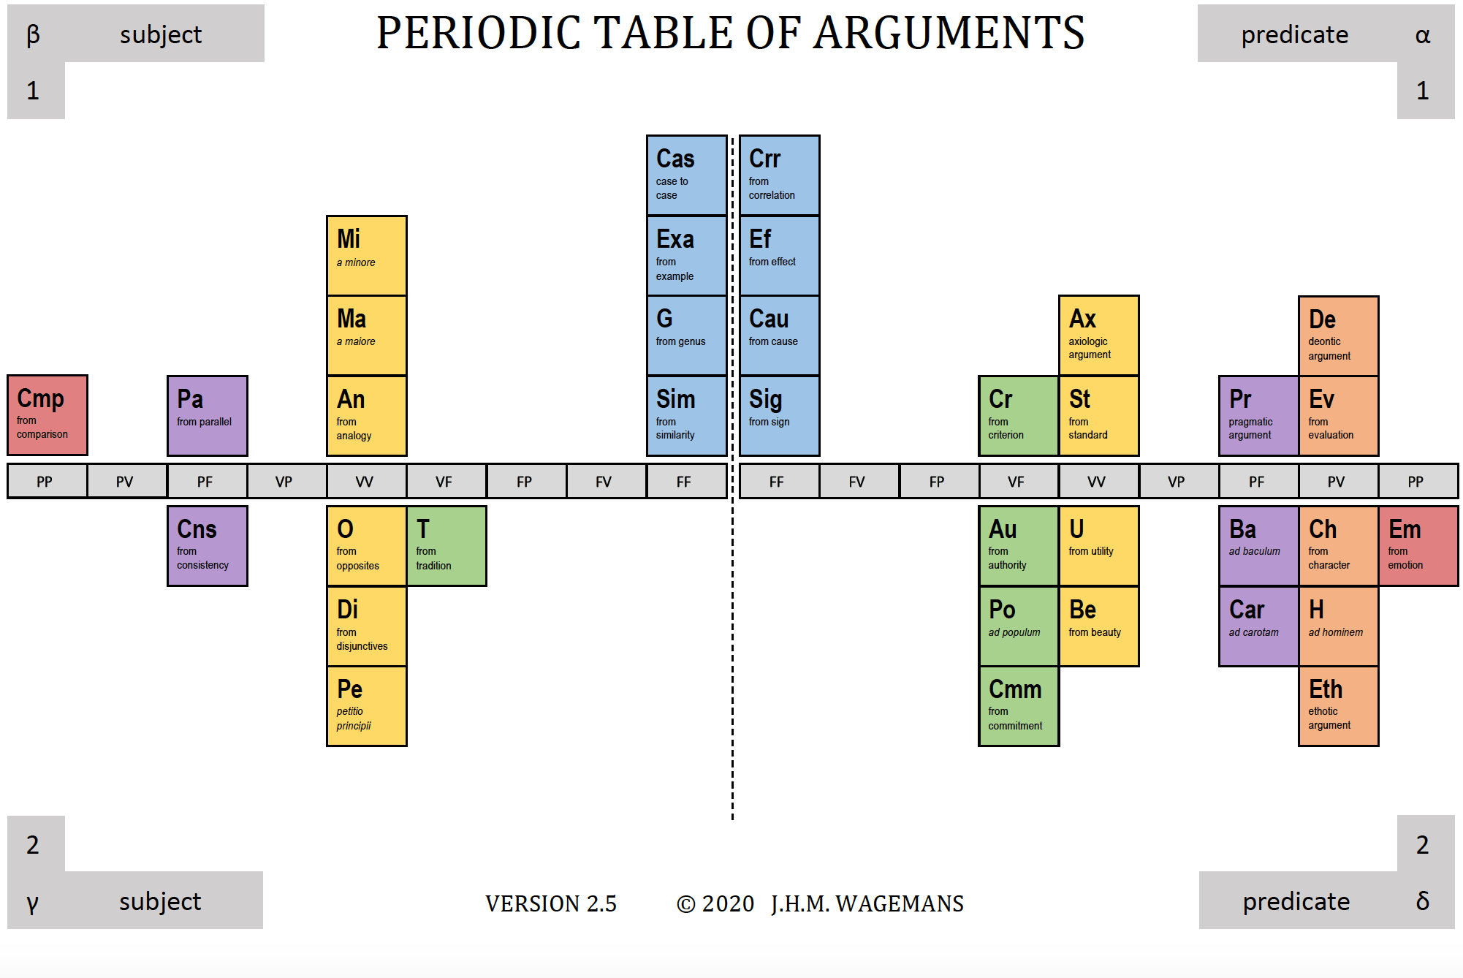
Periodic Table
of Arguments
(Wagemans)

Slide 38
Argument from Cause

Slide 39
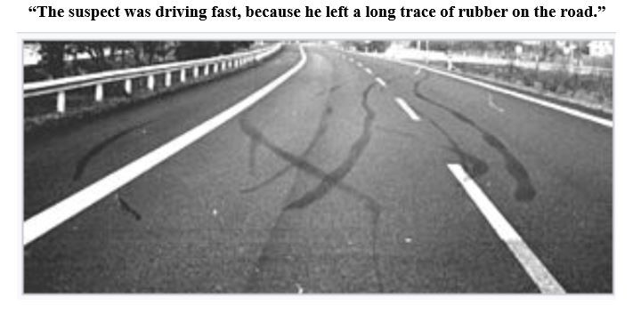

Slide 40
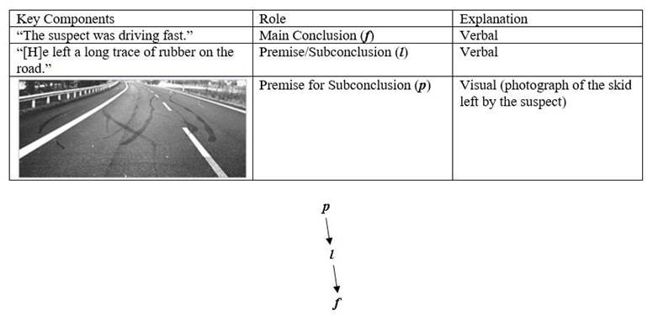
Wagemans
treats this
as a purely verbal
argument,
but…

Slide 41
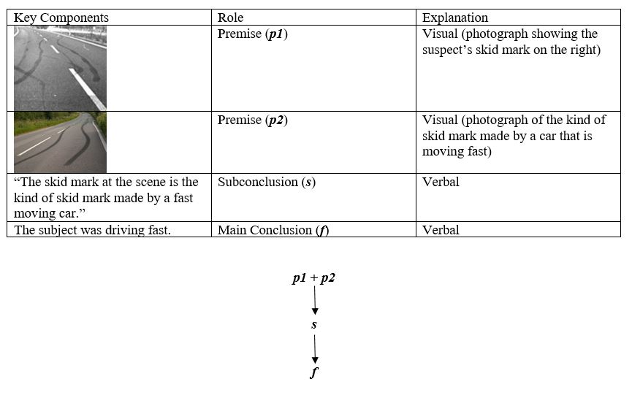
And another visual version…

Slide 42
The Third Way: Visual Schemes

Slide 43
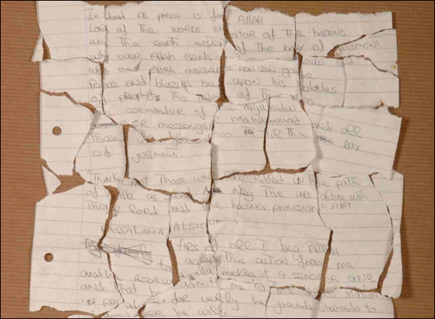
Argument from fit
(Dove)

Slide 44
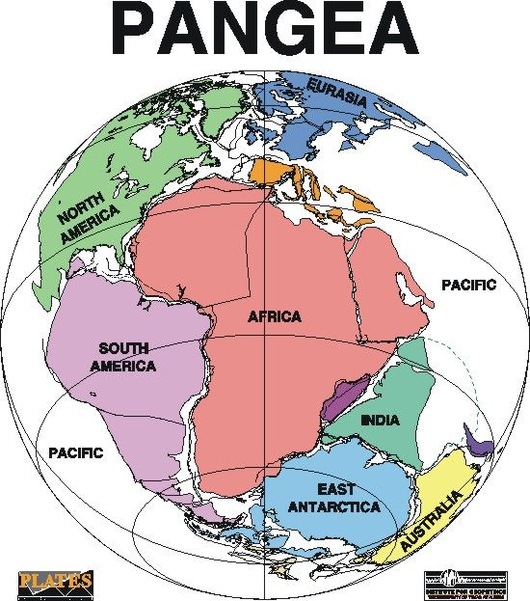
Argument from fit

Slide 45
Just the beginning:

Slide 46
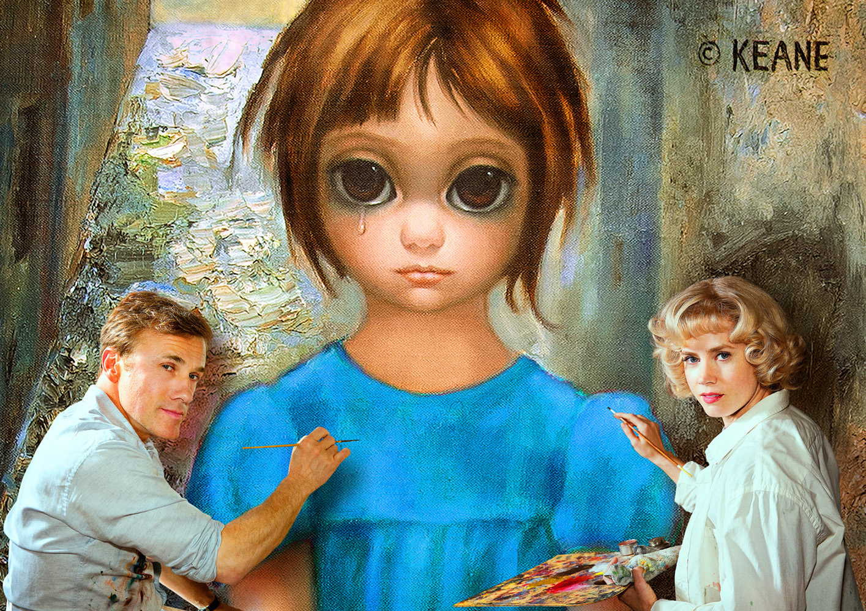

Slide 47
In Keane v. Keane (893 F.2d 1338, 9th Cir. 1990), Margaret Keane sued Walter Keane for damages, claiming that she (and not he) was the artist who painted the famous “Big Eye” paintings of children that were fashionable in the United States in the 1960s. Judge Harold M. Fong directed Margaret and Walter to show that they could paint in the Big Eye style by painting a canvas in front of the court. Walter declined, saying he had a sore shoulder, but Margaret agreed to do so. The court looked on as she arranged an easel and painted a young boy in the Big Eye style. The painting she produced was designated “Exhibit 224.”

Slide 48
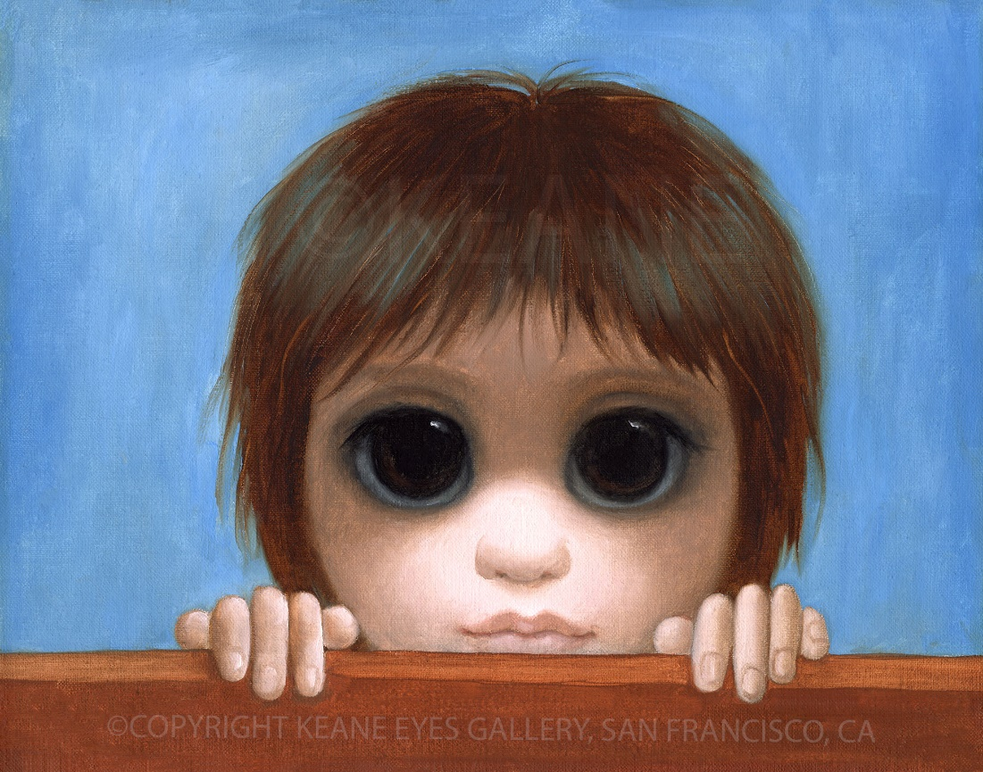
EXHIBIT224

Slide 49
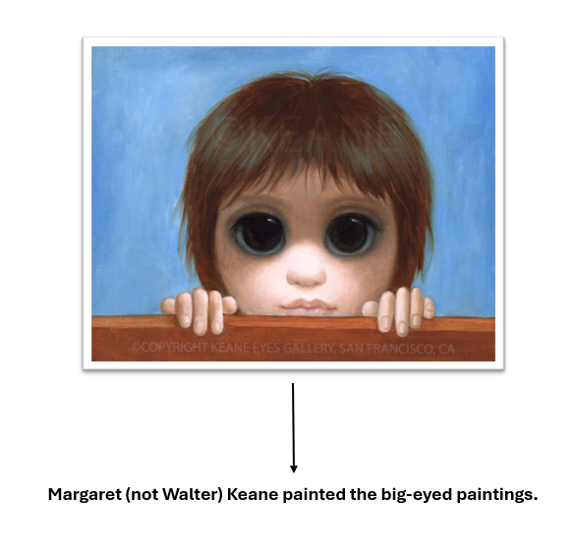
1. Invalid

Slide 50
A weak
inference

Slide 51
Beyond the Visual Mode of Arguing

Slide 52
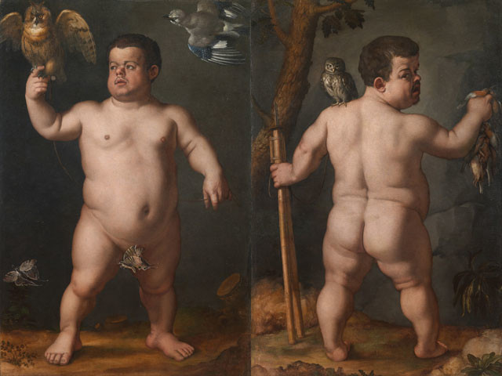
Is painting or sculpture the higher art?
BRONZINO (16th C) C)

Slide 53
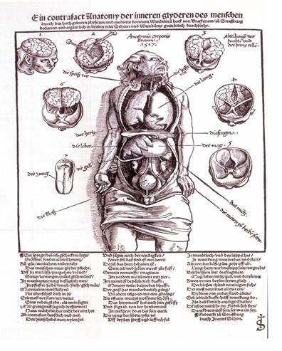
1520s debate about
teaching anatomy
and medicine

Slide 54
Jacques Dubois (1478 –1555)
Dubois lambasted the pictures by Berengario da Carpi in particular as a “hodgepodge,” “sumptuous but useless,” and “shadows.” For Dubois, a medical student needed to reach down into the human body and handle its parts, not just stop at the surface displayed in a picture. He asked, rhetorically: If Galen said that plants did not need to be displayed but should be taught and learned with one’s hands, surely he would not have tolerated futile and inane pictures of the human body. Would he have accepted a physician trained by pictures, unless he intended to cure picture-people (pictos homines)? (Kusukawa 2012, p. 184)

