Slide 1

Evaluating Visual Arguments
Professor Leo Groarke
Trent University

Slide 2

Judging Soundness 1: Looking for Acceptable Premises

Slide 3

Sound Arguments have acceptable premises and a valid inference. Premises can be acceptable in a variety of ways:
by definition;
as a reliable factual statement or testimony of a witness;
by being self-evident or common knowledge; or
as a conclusion of a convincing subargument.
engin akyurt, unsplash

Slide 4

Judging Soundness 2: Validly Reaching a Conclusion

Slide 5

A STRAW MAN argument mischaracterizes an opponent’s point of view. The unacceptable premises that do so are used to introduce other considerations in premises that are not relevant when we attempt to properly assess the actual point of view.
A RED HERRING diverts attention away from a topic of argument by introducing an issue that changes the topic, not addressing the topic at issue.
A HASTY GENERALIZATION provides some relevant evidence in favour of a conclusion, but insufficient evidence to establish its acceptability.
In all three cases, the result is an argument that is invalid, and hence unsound.

Slide 6

A TRENT RATING SCALE: (considering acceptability, validity, rhetorical, and dialectical considerations).
OUCH, needs work
MAYBE, but some questions
LOOKS GOOD
A STRONG ARGUMENT!

Slide 7
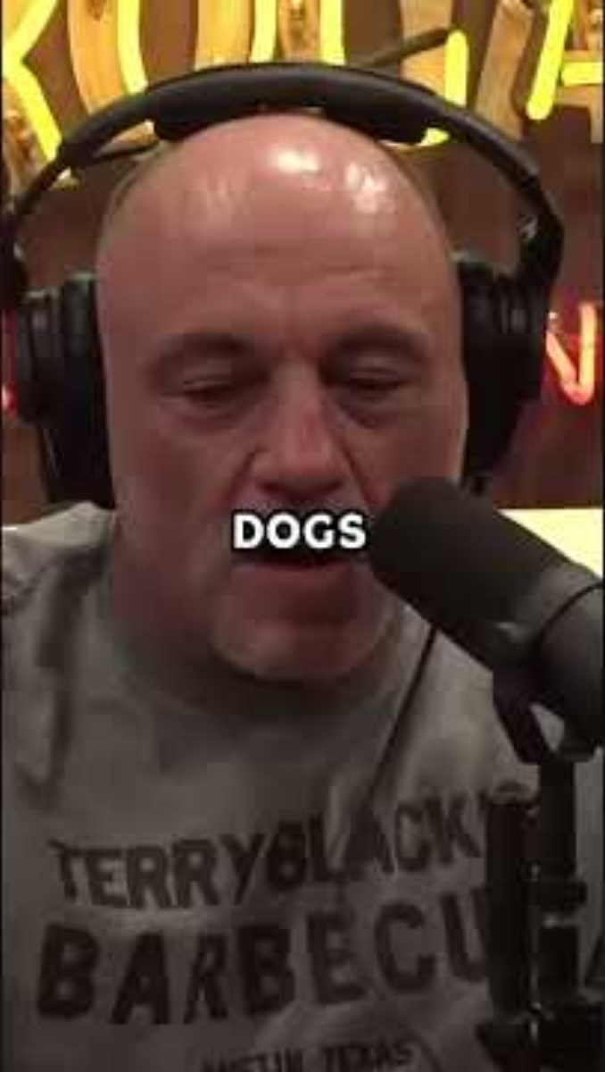
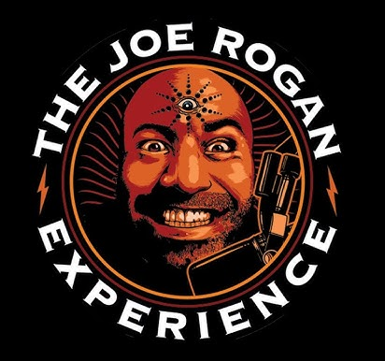

Slide 8
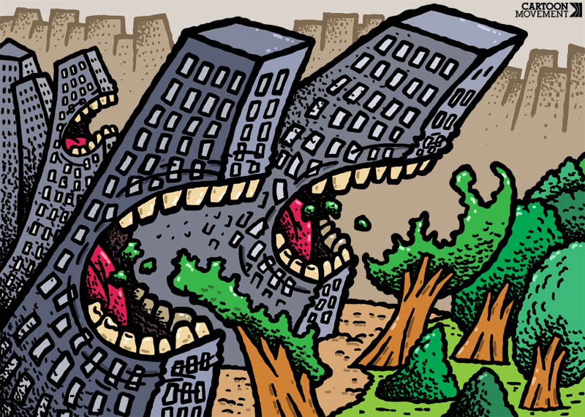
SvitalskyBros cartoon, The Cartoon Movement

Slide 9
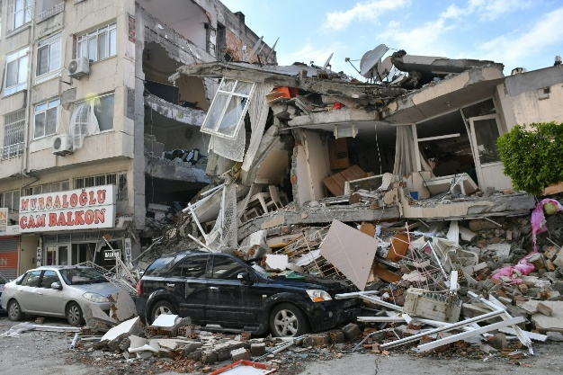

Slide 10
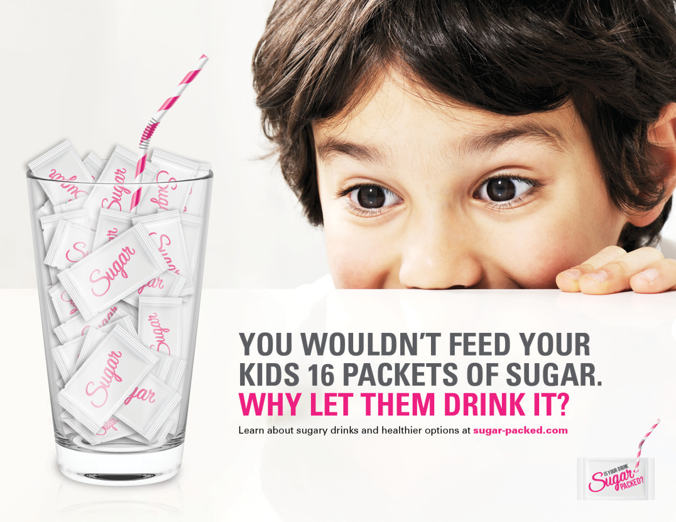
ProductSchool, unsplash

Slide 11
In this case, the question “WHY LET THEM DRINK IT?” is a way to suggest that you shouldn’t let them drink it!
P1 = You wouldn’t feed your kids 16 packets of sugar.
HP =That’s what you are doing when you let them drink sugary drinks (like pop).
HC = You shouldn’t let them drink it.
P1 + HP
C
ProductSchool, unsplash

Slide 12
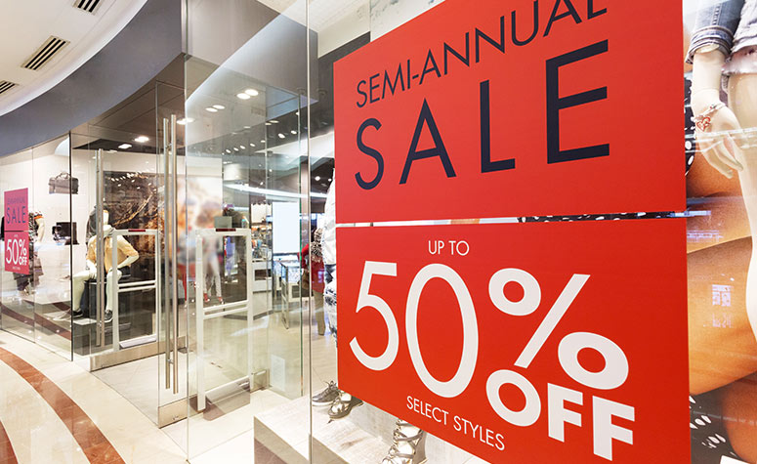

Slide 13




EXAMPLE 4
These signs are an argument. They are designed to provide the reader with a reason (a premise P) in support of the suggestion that one should come in the store and investigate (this is a hidden conclusion HC) .
As premises, the signs could be criticized as vague and possibly misleading (for they include ‘weasel’ words like “UP TO” and “SELECT STYLES, which retract from the significance of the SALE) but there is no reason to think that they are untrue, so they can be judged as acceptable. It may not follow that one should go into the store, that depends on the validity of the inference to that injunction.
P
HC

Slide 14
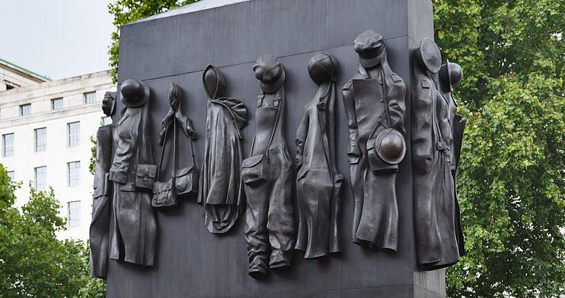

Slide 15
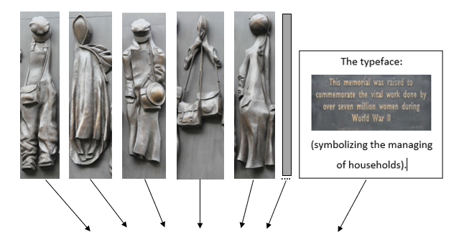

Slide 16
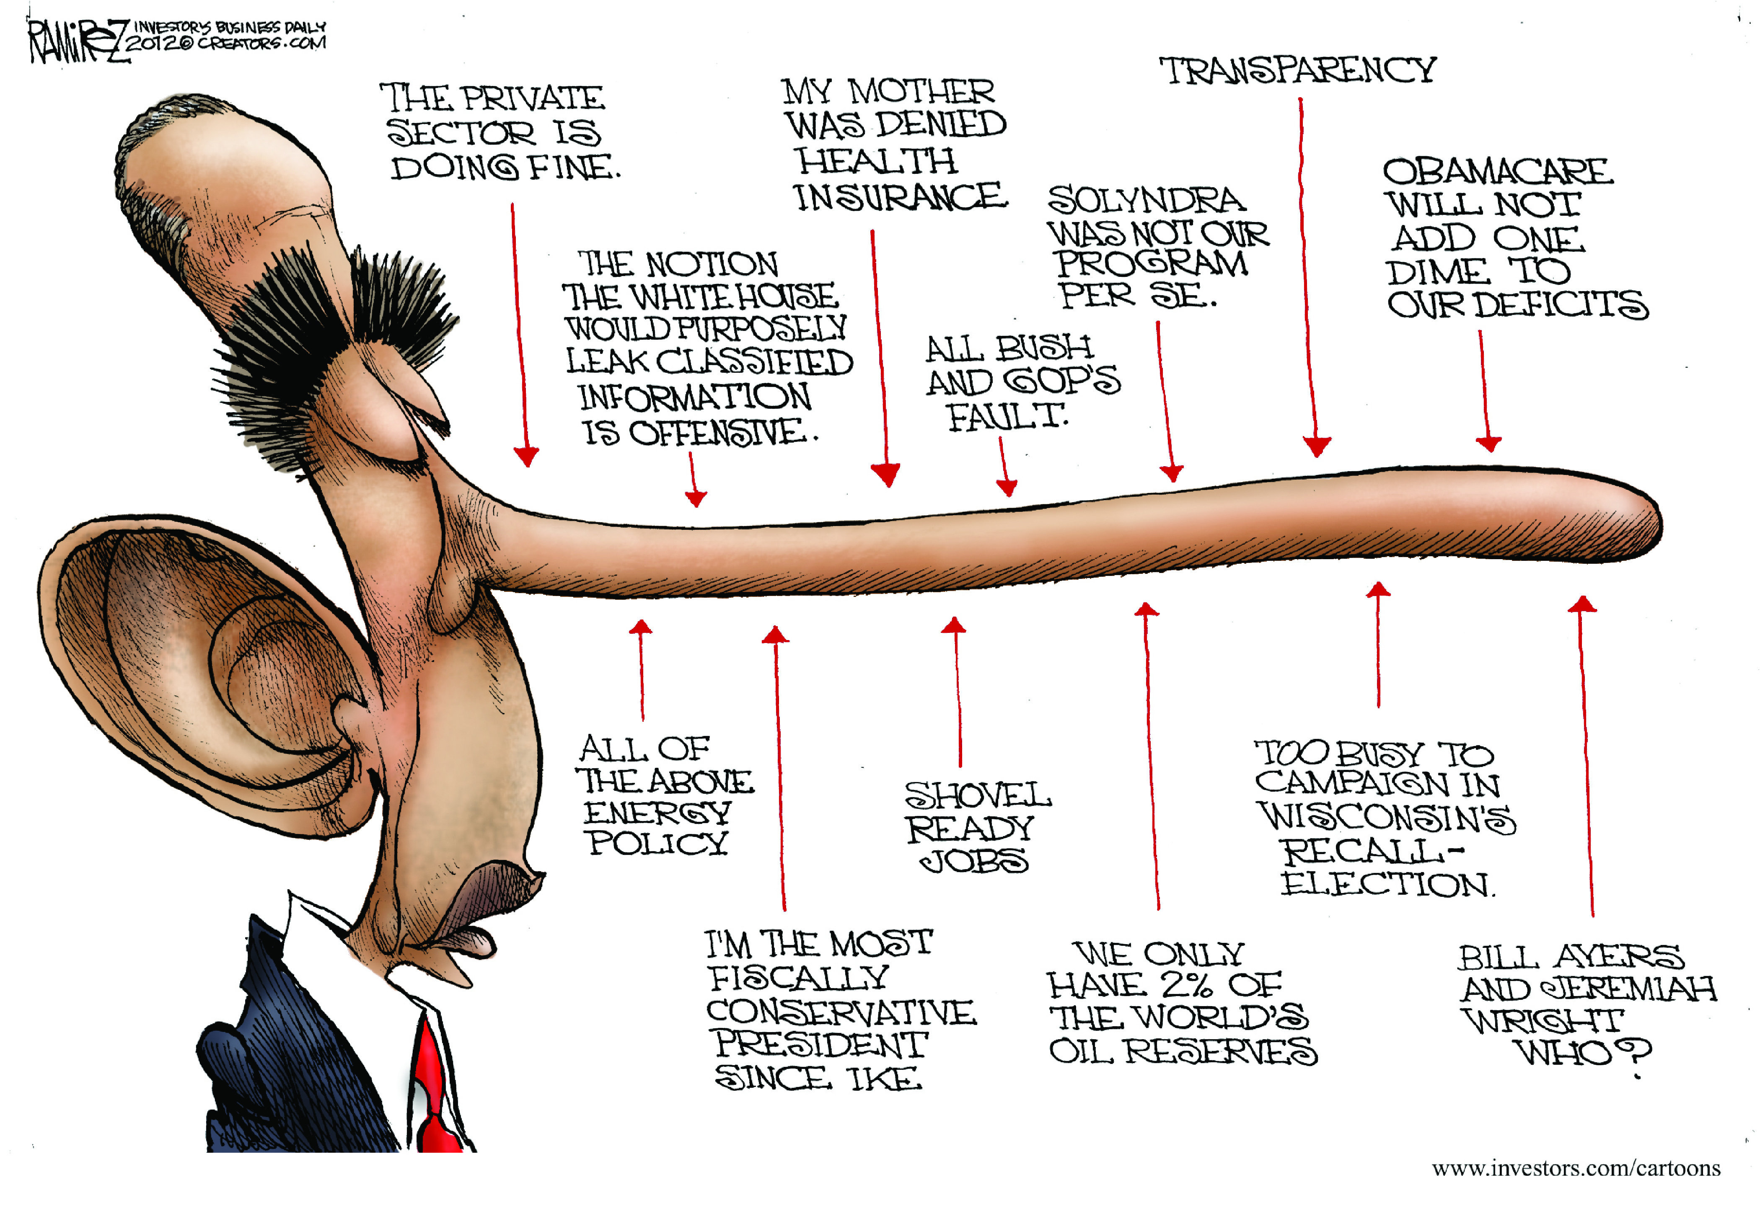

Slide 17
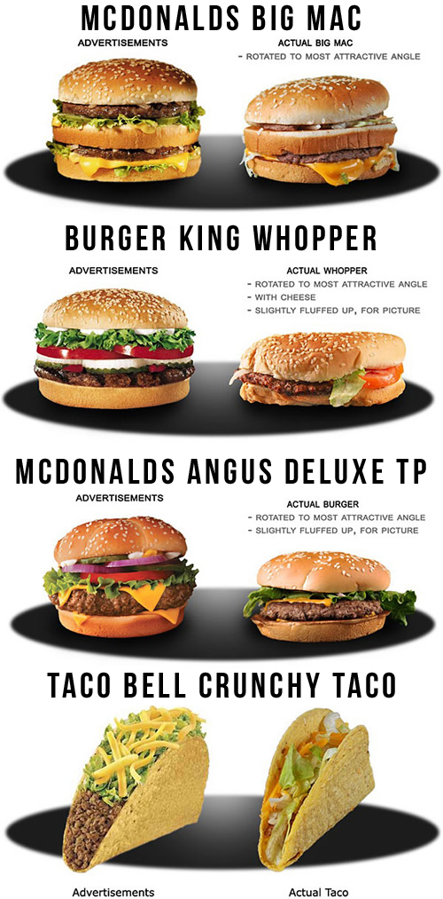

Slide 18
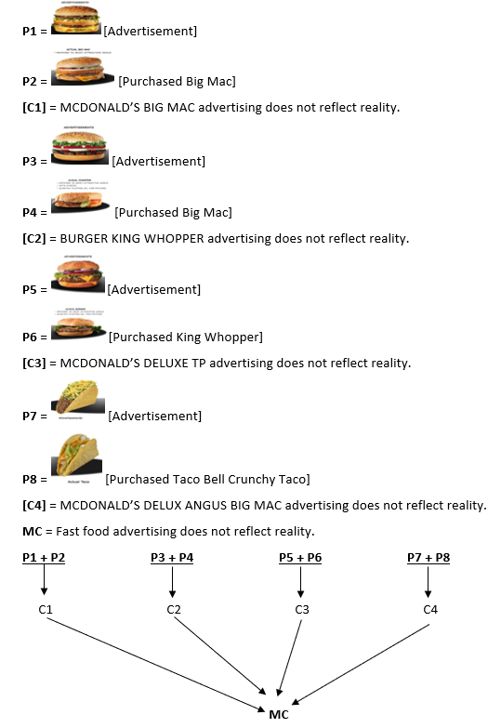

Slide 19
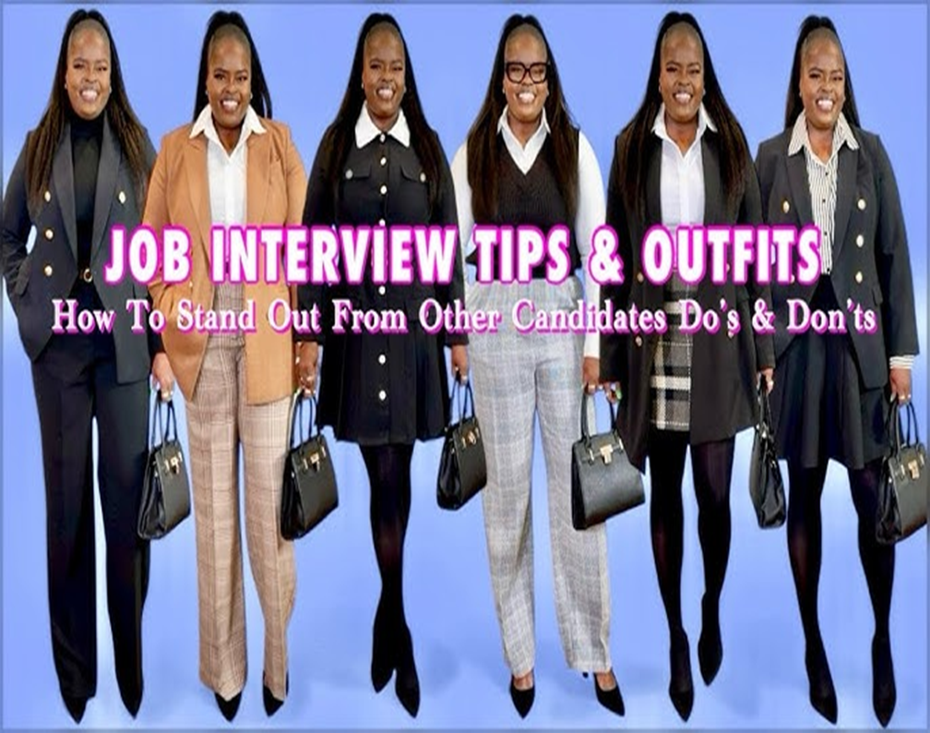
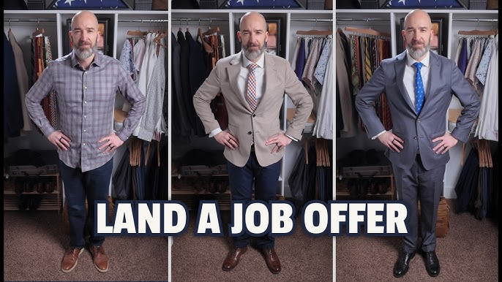

Slide 20
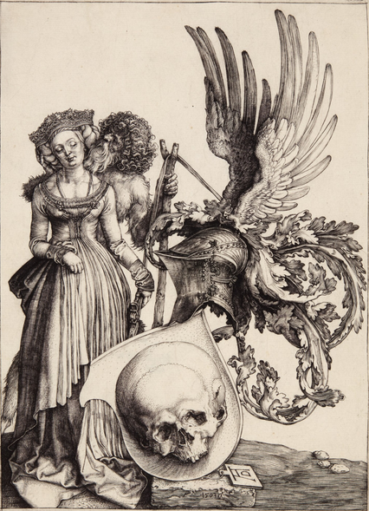

Slide 21
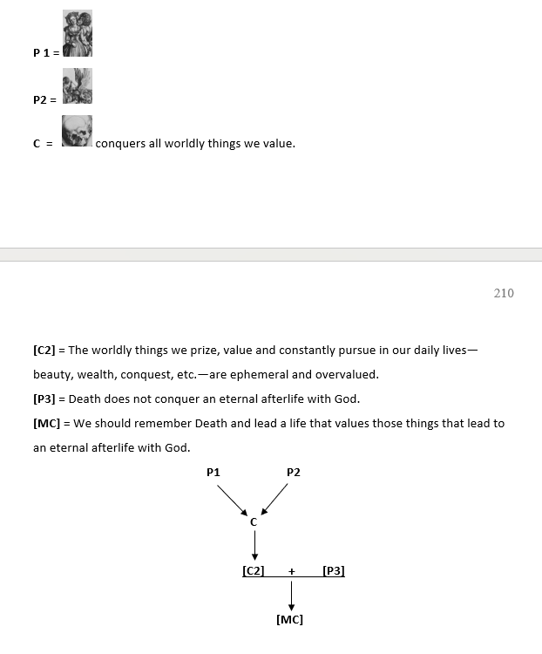

Slide 22
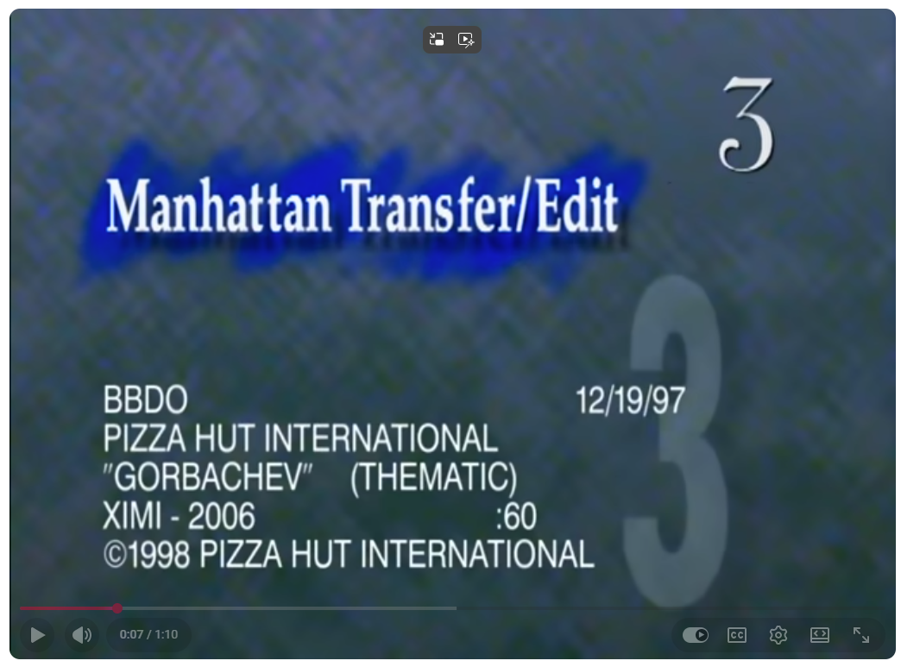
President Mikhail Gorbachev: the last leader of the Soviet Union (from 1985 until the country's dissolution in 1991)
He introduced very controversial reforms, opening Russia to capitalism and the ways of the West. One can get a sense of this from this famous PIZZA HUT commercial in which he participated.
https://www.youtube.com/watch?v=fgm14D1jHUw

Slide 23










A Letter to Time magazine responding to Gorbachev’s remarks saying that he was ending the cold war and agreeing to peace between Russia and the West.
EXAMPLE 5
“Do not trust Mr. Gorbachev’s words.”
Soviet Leader Gorbachev’s words evoke a sense of déjà vu. Where did one read those lines before? Then one remembers. It was in Aesop’s fables. Mr. Fox says to Mr. Cock. “All the animals have agreed to live in peace with one another.” Then the cunning Mr. Fox tries to persuade Mr. Cock to come down from his perch [so that he can eat him].
This gives us a reason for believing a conclusion C (“Do not trust Mr. Gorbachev’s words). The reason is P1: that they are like Mr. Fox’s words in an Aesop’s fable (and the implicit Premise HP2: Mr. Fox is cunning and his words cannot be trusted).
P1 + HP2
C

Slide 24
